Slide 1
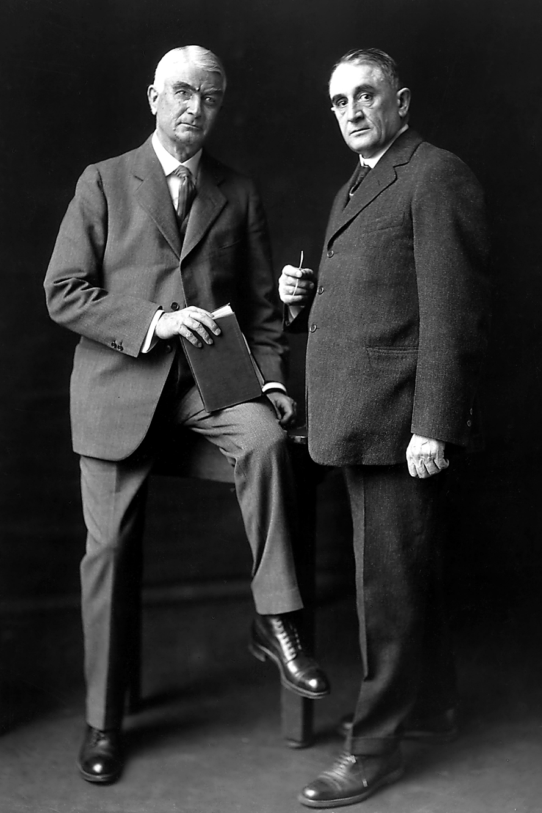
History & Heritage Highlights
©2023 Mayo Foundation for Medical Education and Research

Slide 2
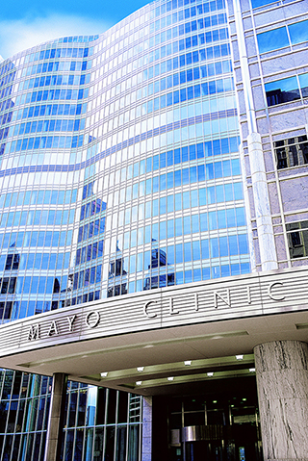
Mayo Clinic is…
The first and largest integrated, not-for-profit medical group practice in the world.
But how did Mayo Clinic begin? 

Slide 3
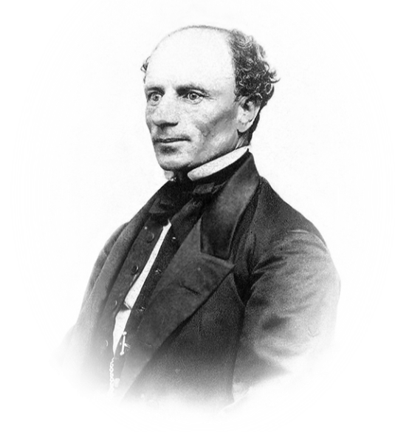
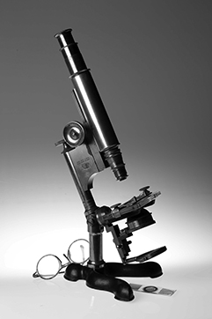
1864
Dr. William Worrall Mayo came to Rochester to examine recruits for the Union Army. He moved his young family to Rochester in 1864.
As his medical practice grew Dr. Mayo and his wife, Louise, mortgaged their home to purchase a microscope so Dr. Mayo could provide optimal care to his patients.

Slide 4
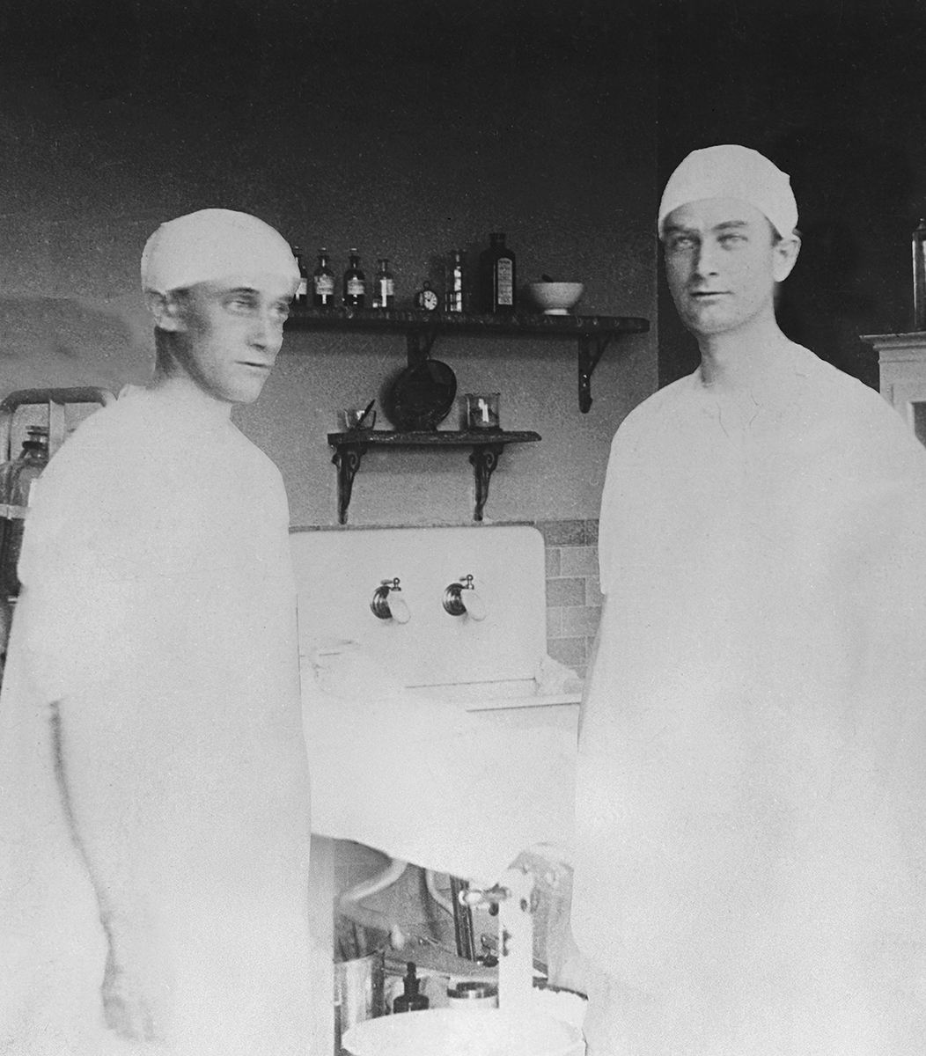
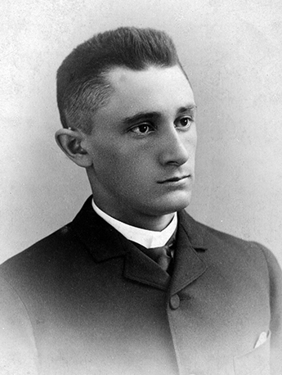
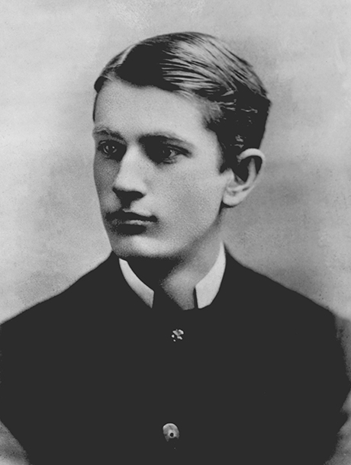
1883 & 1888
Dr. Mayo’s sons, Charles H. and William J., joined him in practice after finishing medical school.

Slide 5
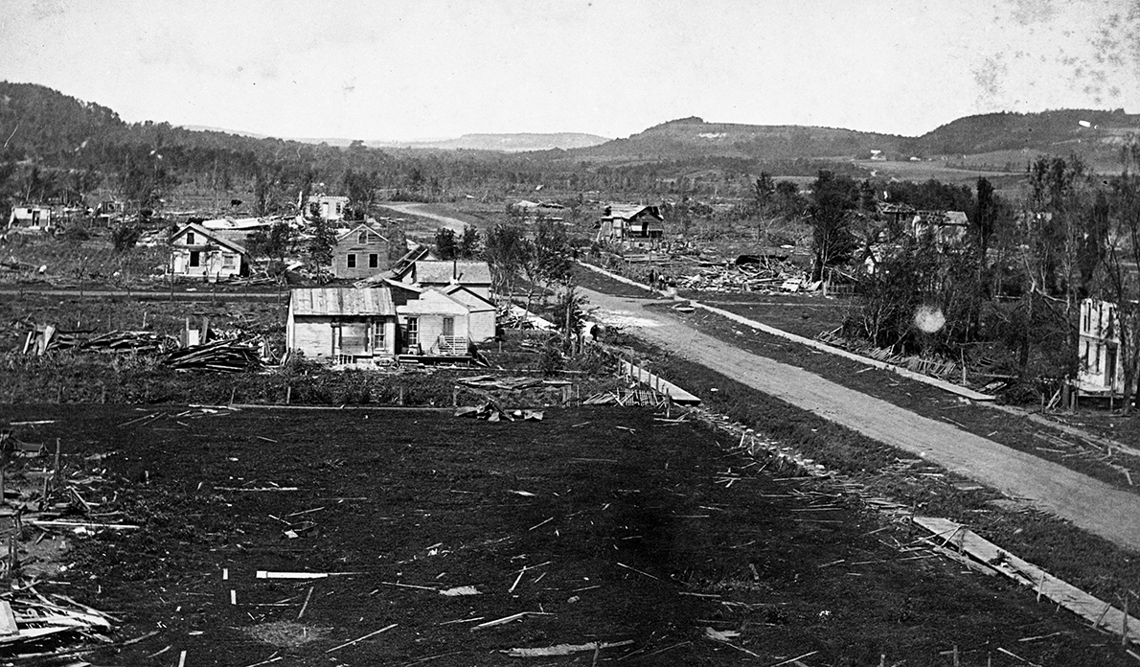
1883④
A devastating tornado struck Rochester, Minnesota.
Dr. W.W. Mayo called on the Sisters of St. Francis, a Catholic teaching order, to assist in providing medical care to the injured.

Slide 6
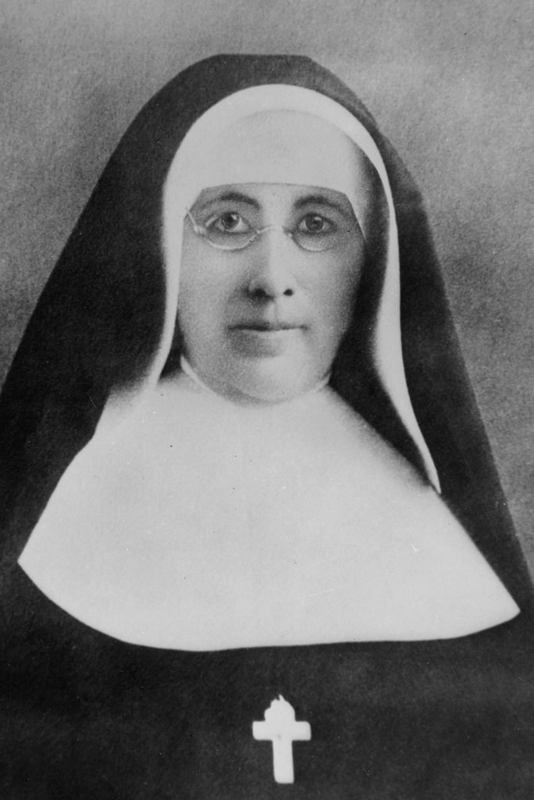
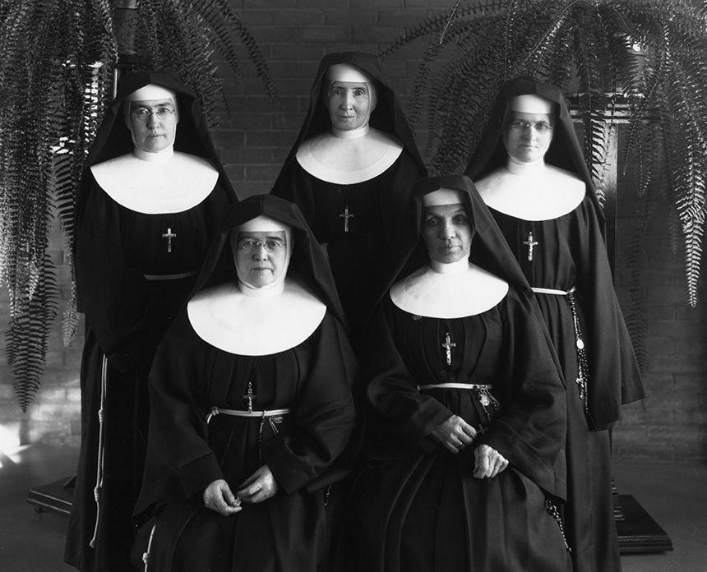
1883
Seeing the need for a hospital in Rochester, Mother Alfred Moes of the Sisters of Saint Francis proposed to build and staff a hospital if Dr. William Worrall Mayo and his sons would provide medical care. Hesitant at first, Dr. Mayo agreed.

Slide 7
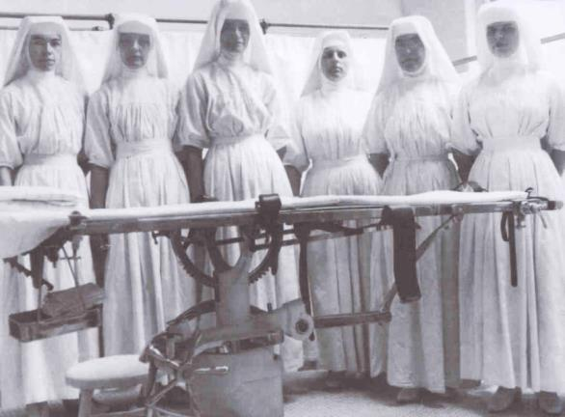
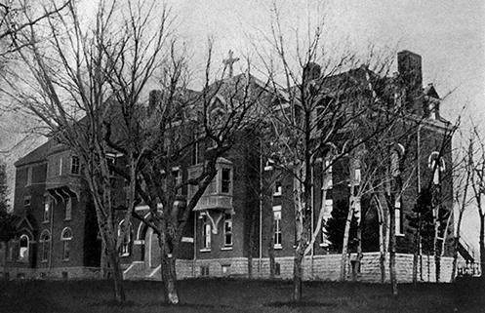
1889
Saint Marys Hospital opened with 27 beds. Word spread of the “hospital in the cornfield” and the skill of the Mayo brothers as surgeons.
The Mayo brothers worked closely with the Franciscan Sisters, employing the latest antiseptic techniques in surgery. In 1906, to address the need for more nurses, the Saint Marys School of Nursing was established.

Slide 8
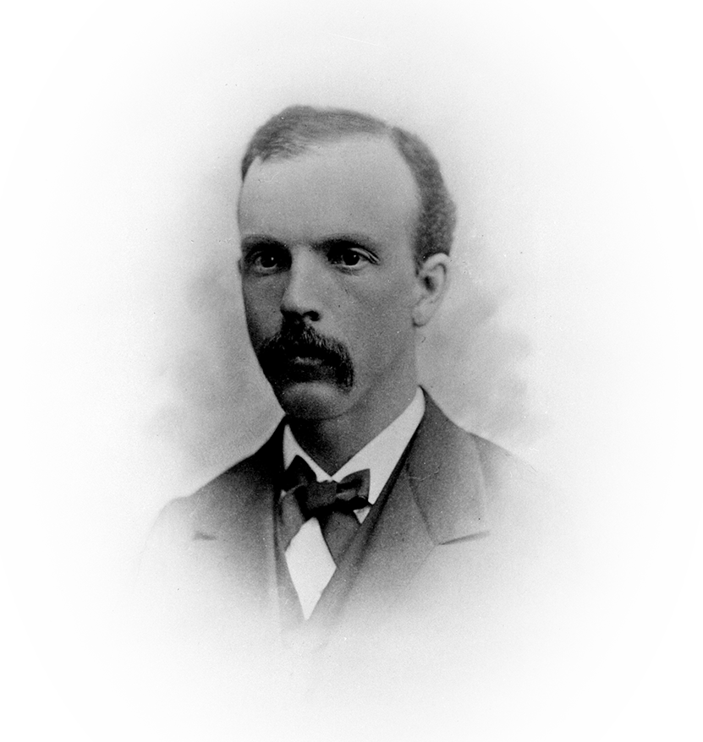
1892
Innovation was the standard of the Mayo practice from the beginning. As the demand for their services increased, Dr. Will and Dr. Charlie asked other doctors and basic science researchers to join them. They welcomed partners and associates whose skills complemented their own, establishing the model of teamwork that continues today.
The first partner, Augustus W. Stinchfield, M.D., was added to the Mayo family practice.

Slide 9
1905
Louis Wilson, M.D., was hired to develop the laboratories. Dr. Wilson also developed a rapid way to diagnose surgical specimens, allowing Mayo surgeons to explore, diagnose and repair tissue all in one operation.

Slide 10
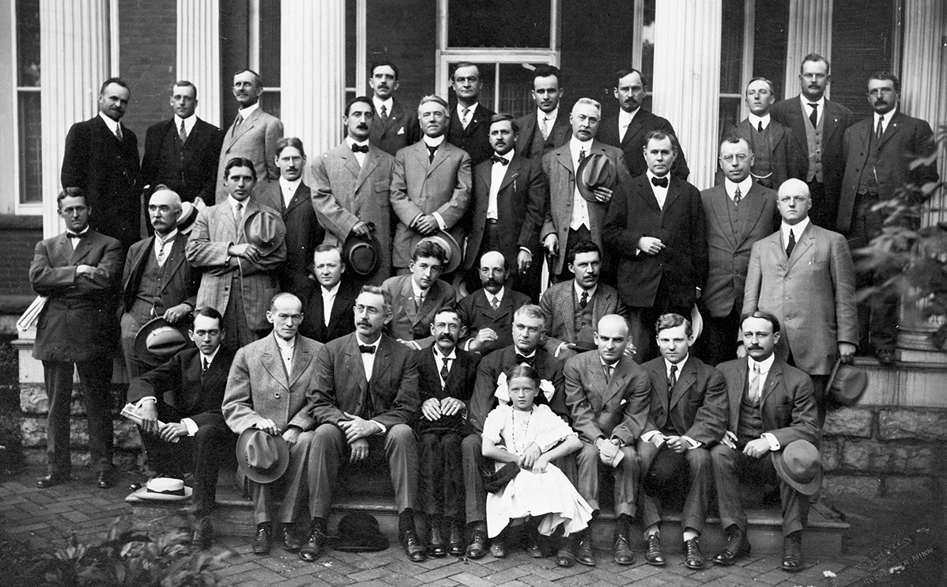
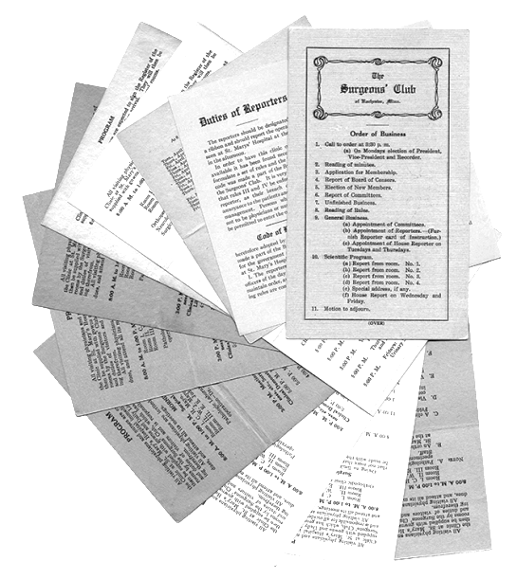
1906
Visiting physicians organized The Surgeons Club, forerunner of Mayo Clinic School of Continuous Professional Development.

Slide 11
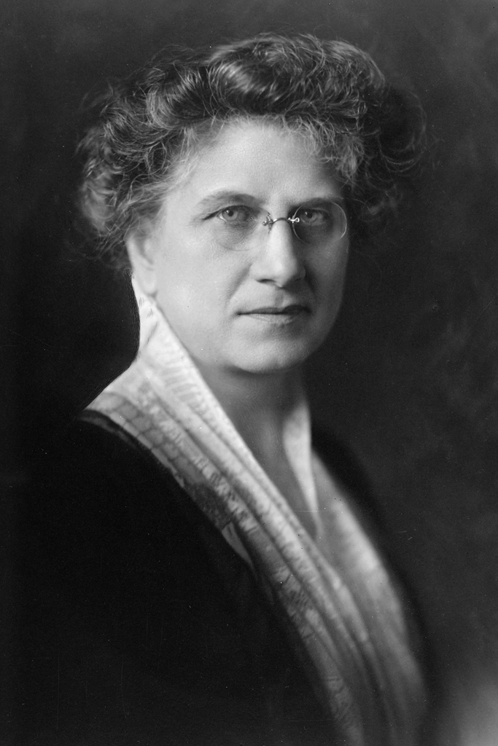
1907
③Henry Plummer, M.D. introduced the concept of integrated medical records for individual patients stored in a central place. The unified medical record continues today in an electronic format. It is the “gold standard” of documentation for patient care, research and education.
Maud Mellish④ was hired to develop a library and perform editorial services for the staff.

Slide 12
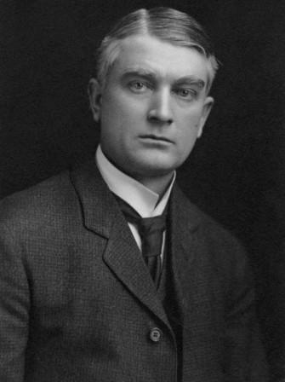
1910
③William J. Mayo, M.D. Delivered the commencement address at Rush Medical College in Chicago. He said:
“The best interest of the patient is the only interest to be considered, and in order that the sick may have the benefit of advancing knowledge, union of forces is necessary.”
His statement becomes the foundation of the primary value of Mayo Clinic – the needs of the patient come first and a classic declaration of Mayo Clinic’s commitment to teamwork.

Slide 13
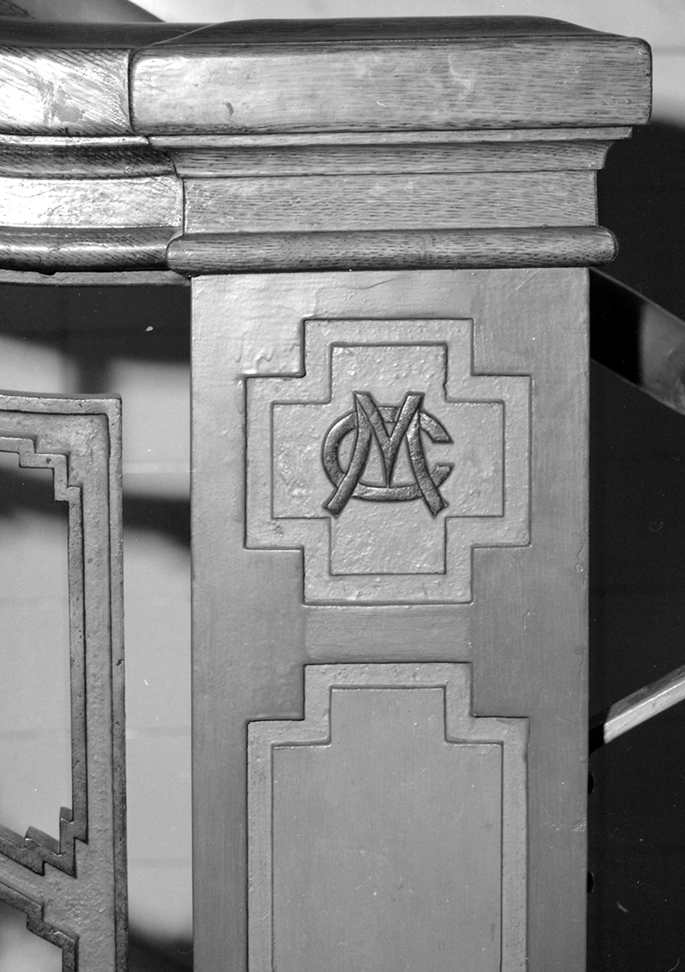
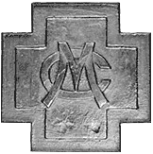
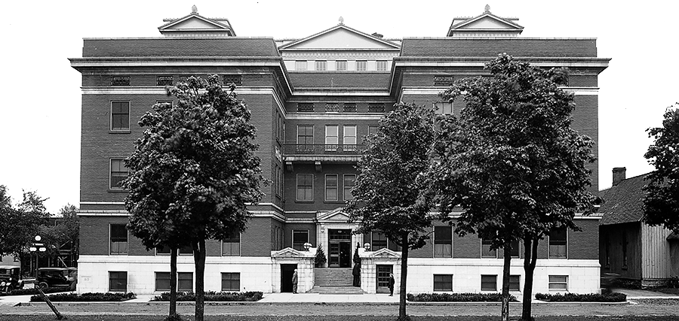
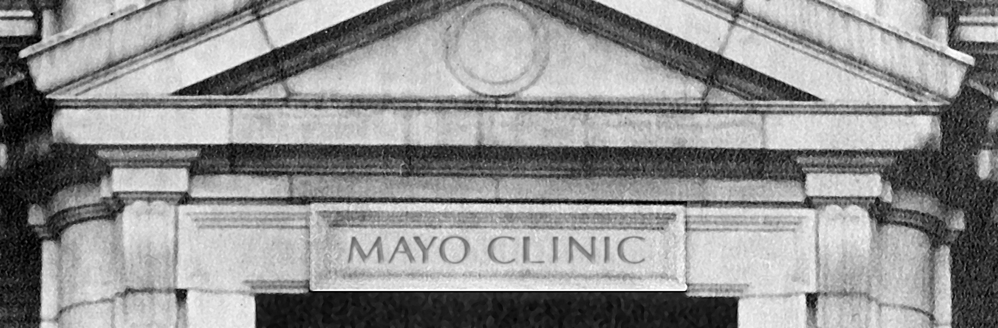
1914
Although the Mayo doctors were initially viewed as unconventional for practicing medicine through this teamwork approach, the benefits of a private group practice were undeniable. When the first building in the world designed for integrated multispecialty group practice of medicine opened in 1914, the name “Mayo Clinic” was carved in stone above the front door.
Mayo Clinic logo – 1914

Slide 14
1917④
③1915
Doctors from all over the world came to observe and learn from the Mayo physicians, leading to the organization of one of the world’s first formal graduate training programs for physicians. Today it is known as the Mayo Clinic School of Graduate Medical Education.
Physicians who trained at Mayo Clinic established what now is known as the Mayo Clinic Alumni Association.

Slide 15
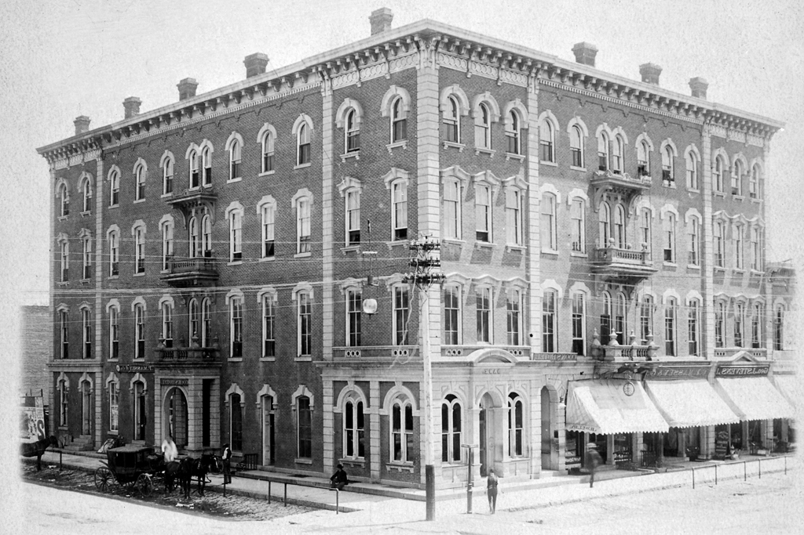
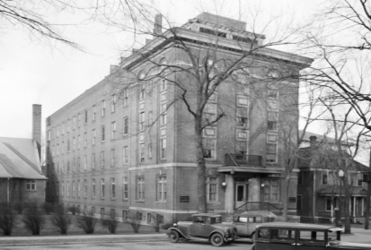
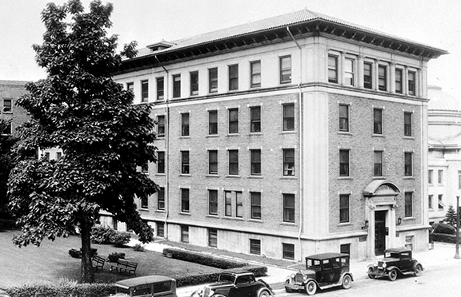
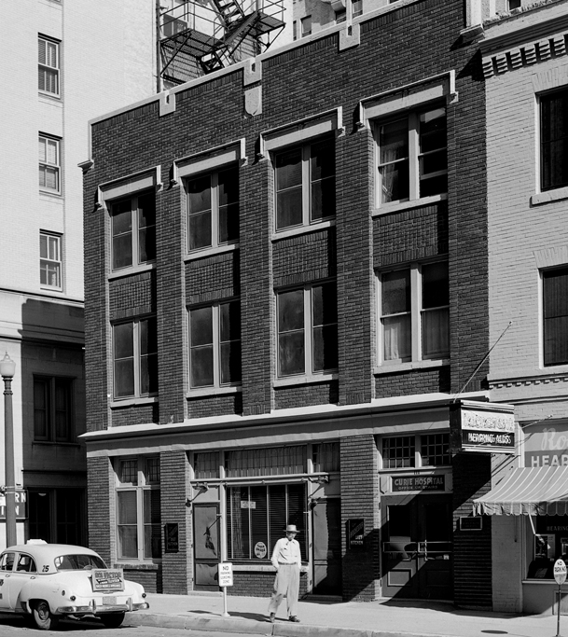
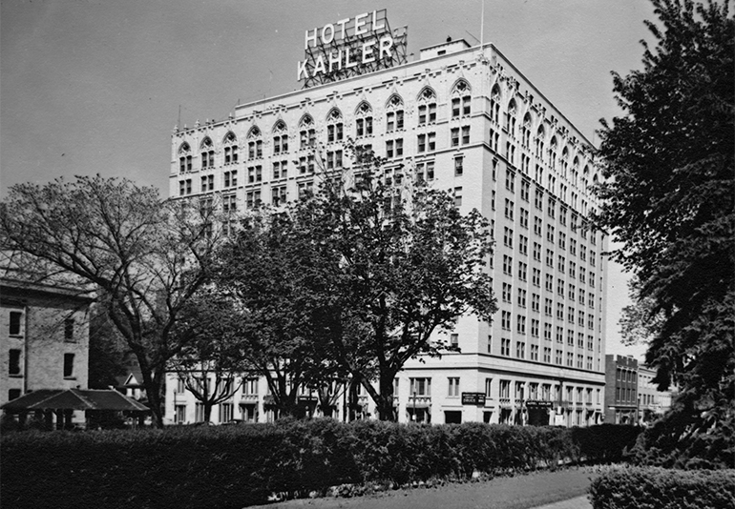
By 1915…
③Cook Hotel
Saint Marys Hospital could not meet the rising demand from patients. Rochester business leader John Kahler developed an innovative concept of hotel/hospitals in downtown Rochester, providing patients with increased access to medical care and places to recuperate from surgery.
①Worrall Hospital
③Worrall Annex
Kahler Hotel & Hospital②
①Curie Hospital

Slide 16
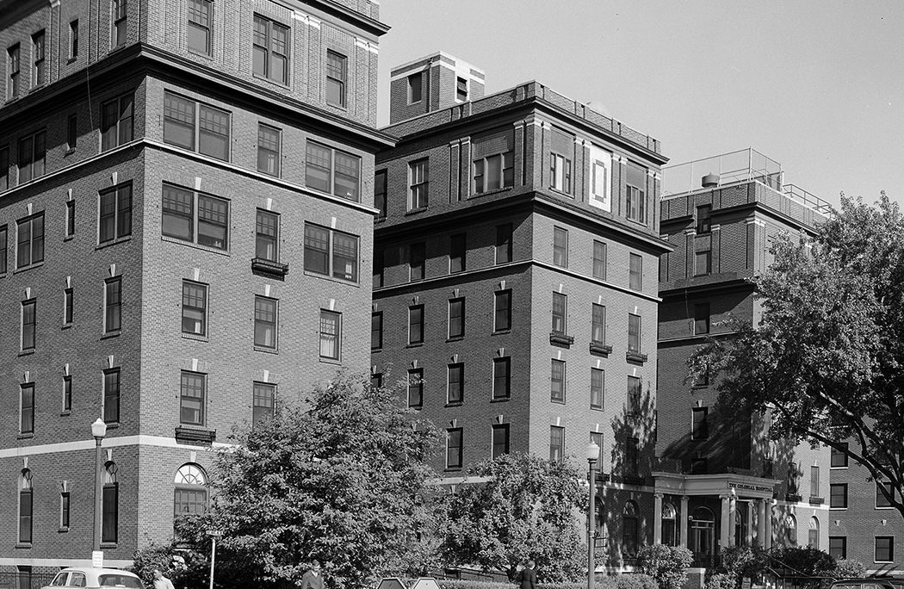
1919
Colonial Hospital Training School for Nurses was established in downtown Rochester.
In 1921 the name was changed to Kahler Hospital’s School of Nursing.

Slide 17
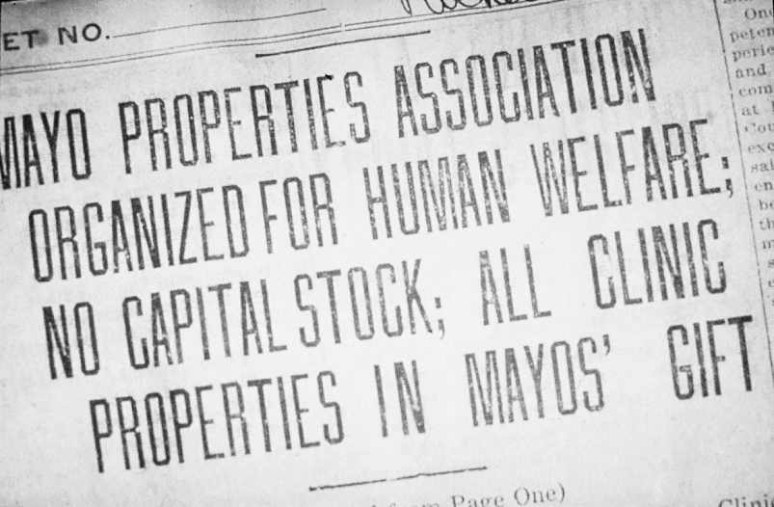
1919
To ensure the longevity of Mayo Clinic, the Mayo brothers and their wives signed a Deed of Gift, donating the assets of the private practice and the majority of their private savings to create a not-for-profit organization.
This gift, worth about $10 million at the time, was without precedent in medicine.

Slide 18
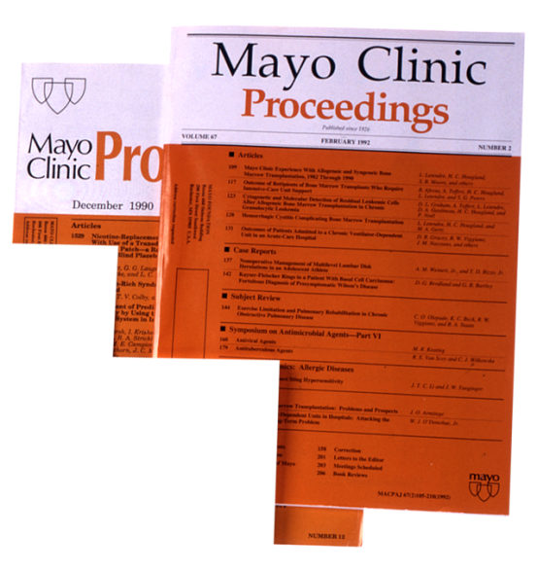
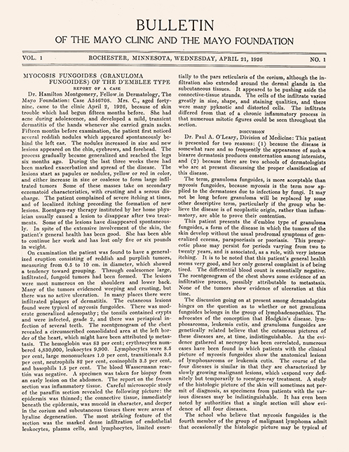
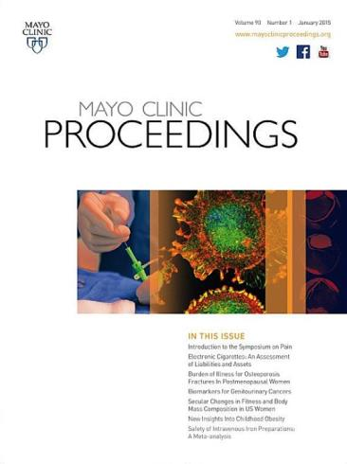
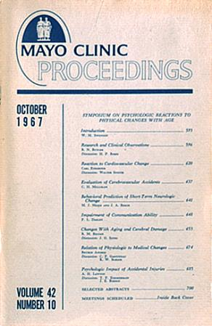
1926
The first issue of Mayo Clinic Proceedings was published. Originally a summary of staff activities (Bulletin), in 2021, there were more than 6 million downloads of its journal content.
Mayo Clinic logo – 1927

Slide 19
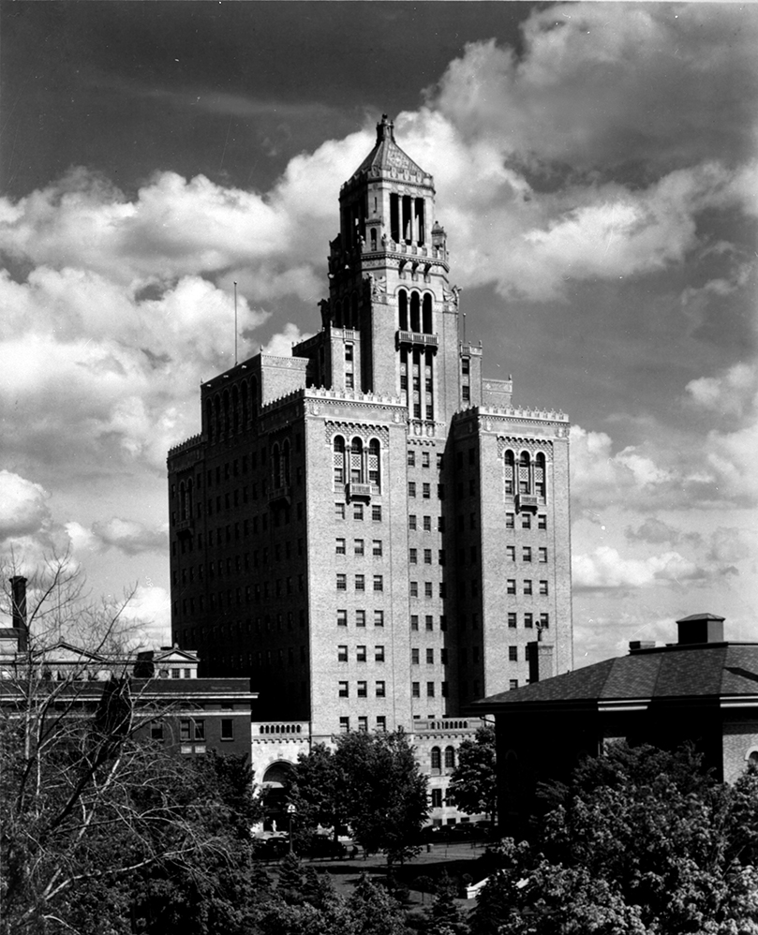
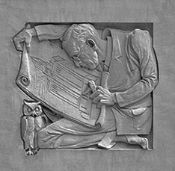
1928
The Plummer Building opened. A triumph of engineering and aesthetics, it exemplifies the Mayo brothers’ ideal of serving humanity through medical science.

Slide 20
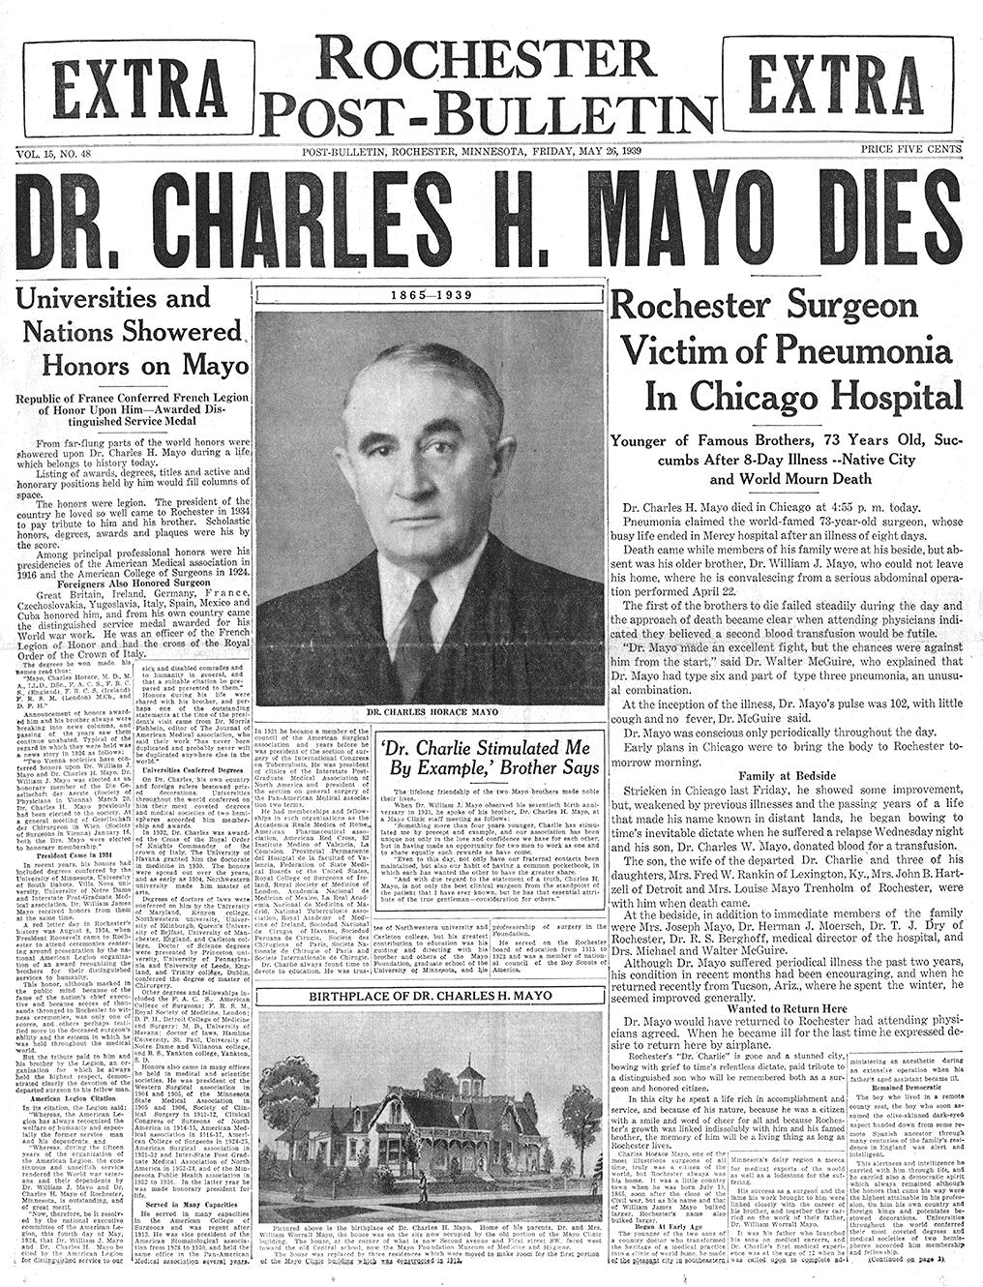
May 26, 1939
After an eight-day illness, Dr. Charlie passed away in a Chicago hospital.
The nation and the world joined Rochester residents in mourning his death.

Slide 21
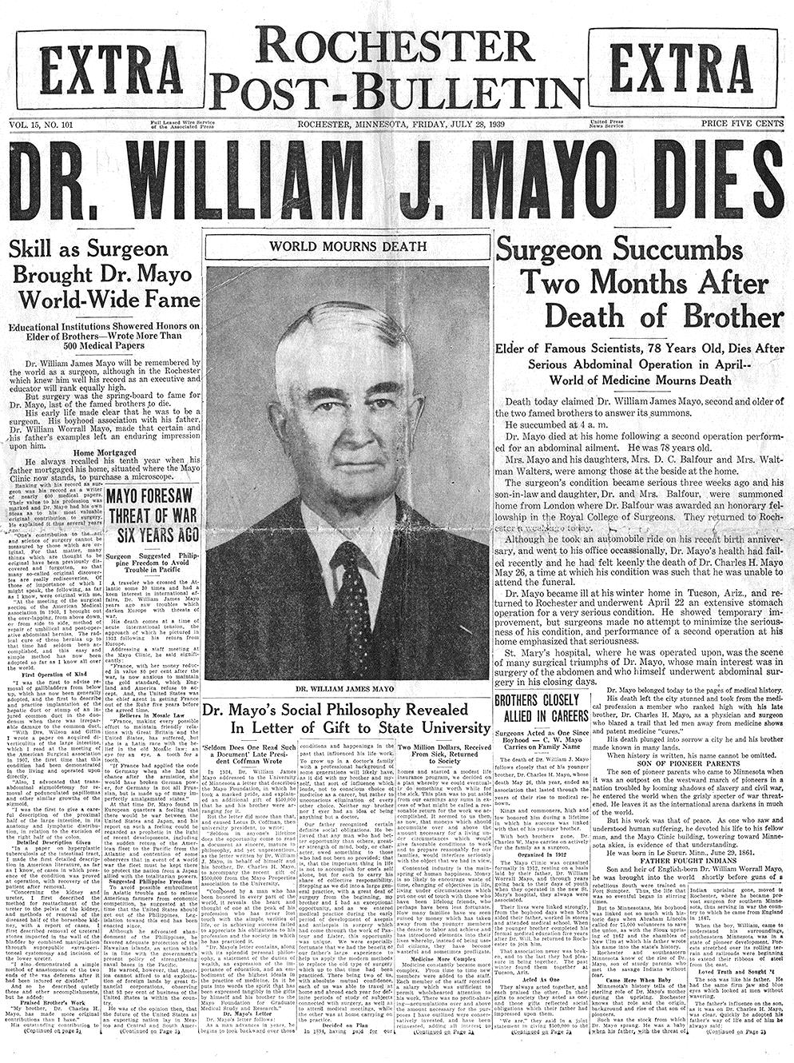
July 28, 1939
Only two months later, the world mourned once again when Dr. Will passed away in Rochester.
Many expected the demise of Mayo Clinic.
Yet so carefully had the brothers planned and so graciously had they welcomed capable colleagues to positions of leadership that Mayo Clinic continued to thrive.

Slide 22
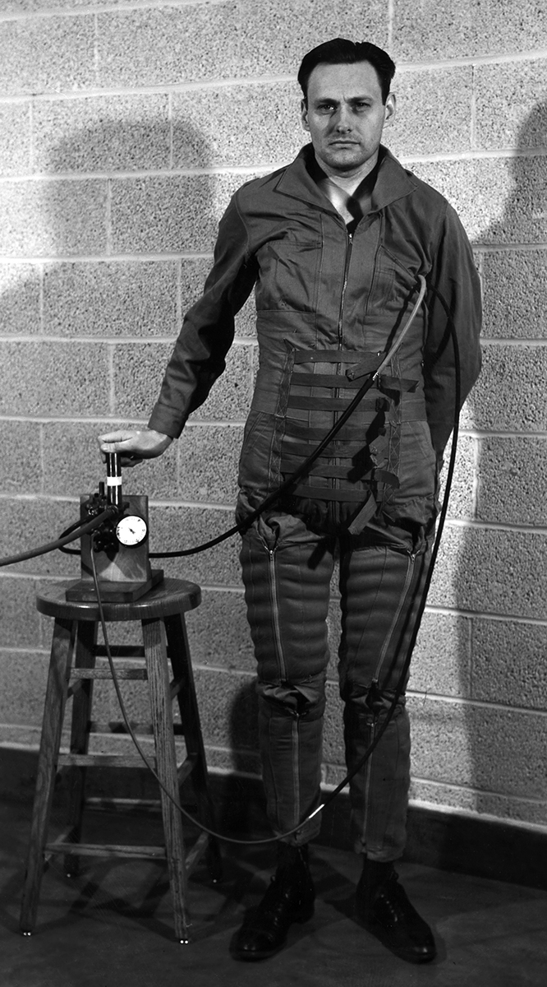
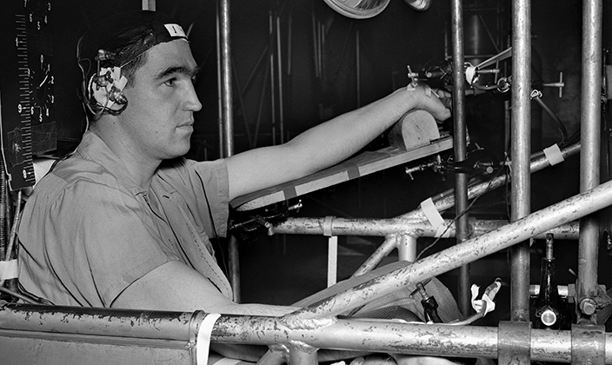
World War II
Mayo Clinic conducted Top Secret research to help protect pilots and flight crews. Mayo’s Aero Medical Unit helped develop the oxygen mask and G-suit that gave American aviators a decided advantage in the air war in Europe and the Pacific.

Slide 23
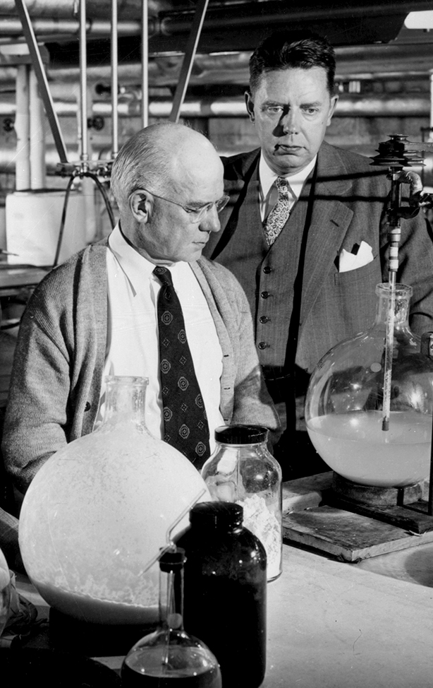
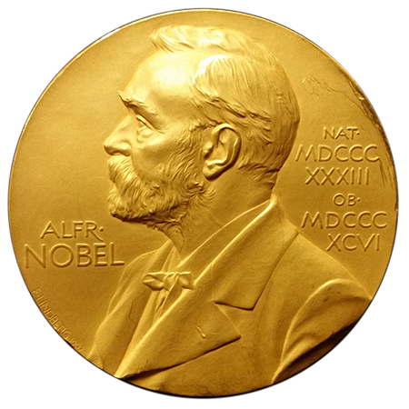
1950
Mayo Clinic researchers Edward Kendall, Ph.D. (left), and Philip Hench, M.D. (right), shared the Nobel Prize for discovery of cortisone.

Slide 24
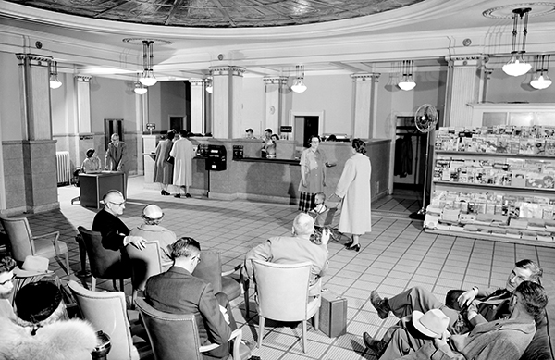
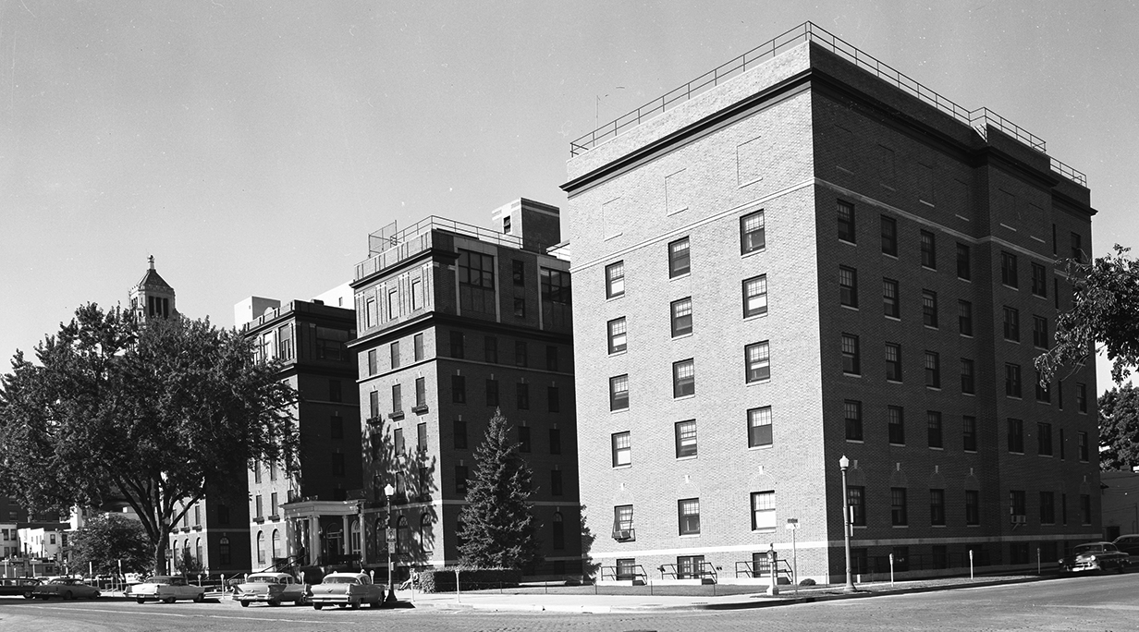
Early 1950s
The Kahler Corporation moved away from managing hospitals.
Through the efforts of local business leaders, Mayo Clinic officials and the Methodist National Board of Hospitals and Homes, Rochester Methodist Hospital became a corporate reality in 1954.

Slide 25
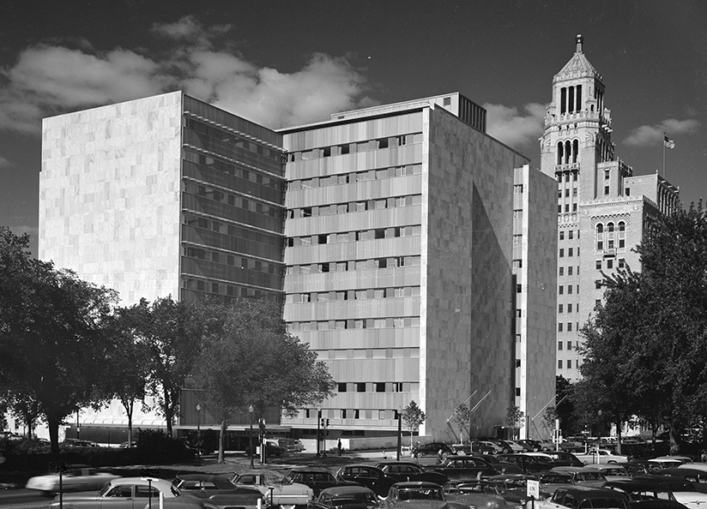
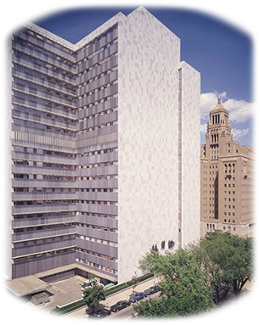
1955
Unprecedented growth of the Clinic prompted construction of the Mayo Building. The 10-story building was completed in 1955.
An eight-story addition was completed between 1966-1970.

Slide 26
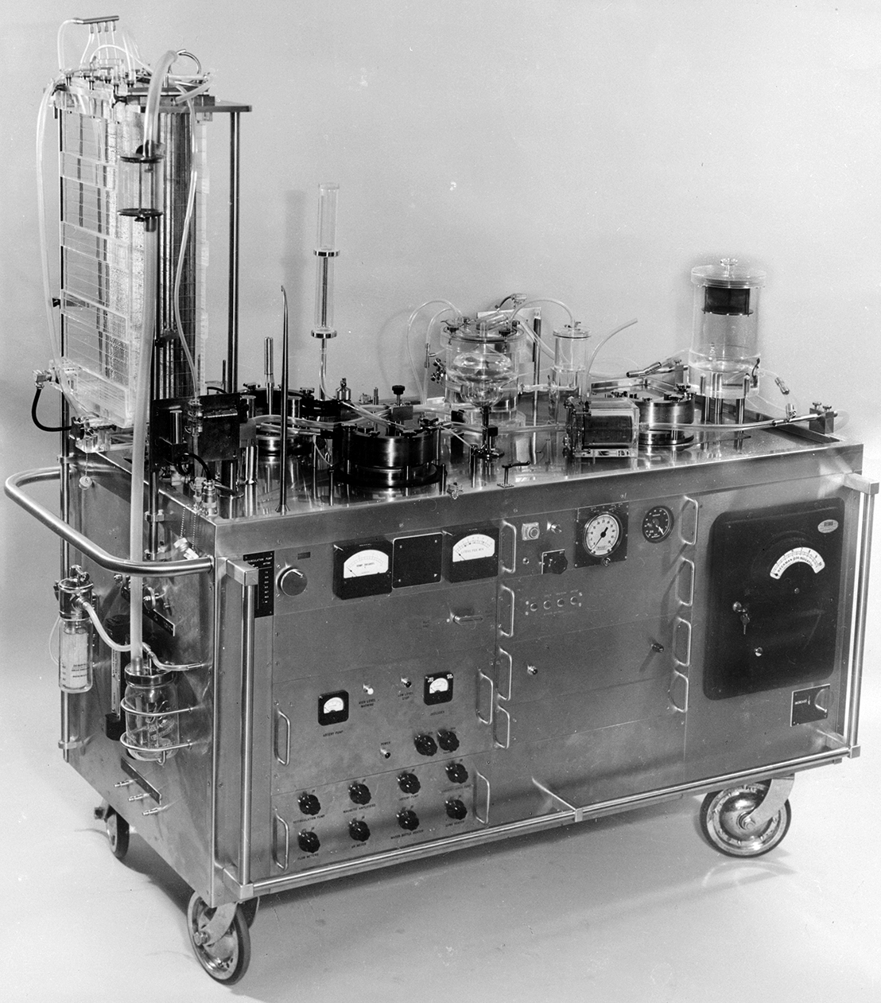
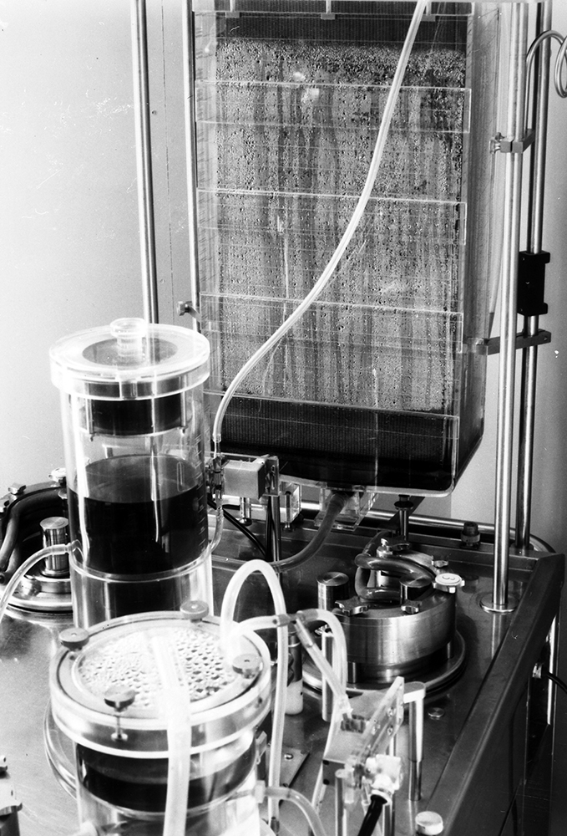
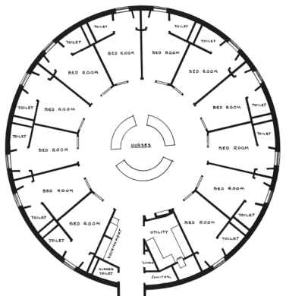
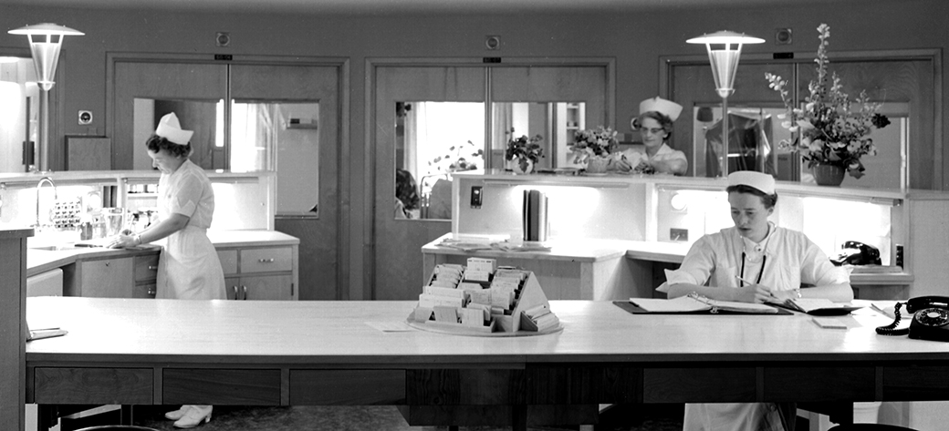
1955
③Mayo Clinic helped revolutionize open-heart surgery with the Mayo-Gibbon Heart-Lung Bypass Machine.
Subsequent developments at Mayo Clinic included one of the first intensive care units in the United States.②

Slide 27
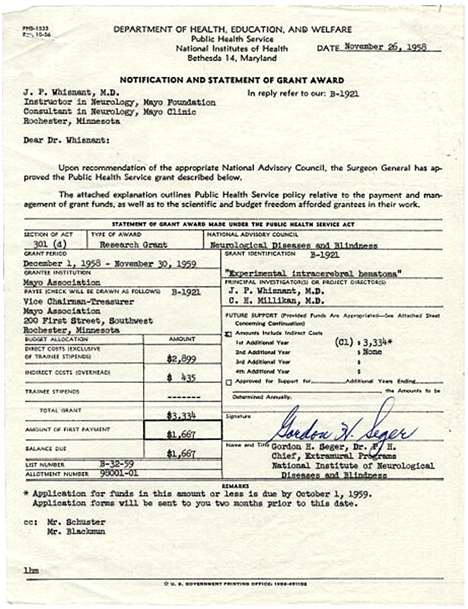
1958
Mayo Clinic received its first grant from the National Institutes of Health (NIH).
Today, Mayo Clinic is one of the leading recipients of NIH funding, which confirms the high quality of Mayo’s research initiatives.

Slide 28
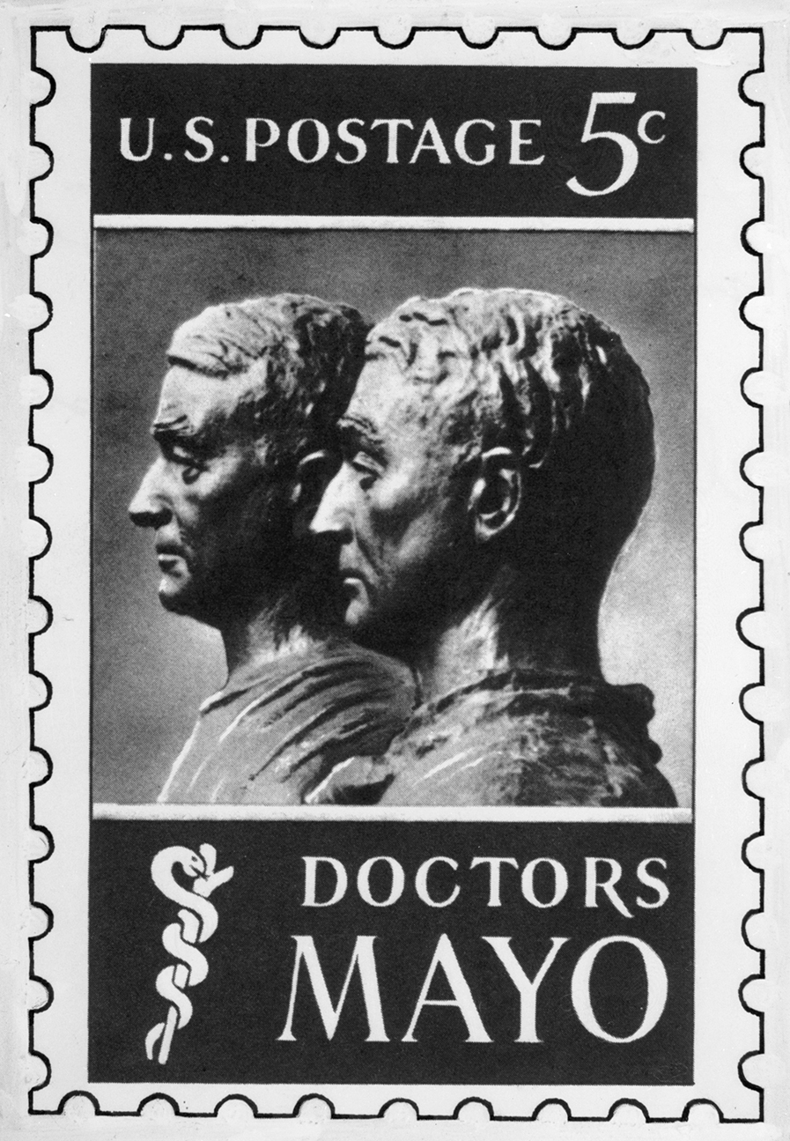
1964
The Mayo Centennial Year included scientific and cultural programming.
The U.S. Postal Service issued a stamp in honor of the Mayo brothers.
The centennial seal was the first depiction of practice (patient care), education and research, which were visually represented in the 1970s as the three-shield logo of Mayo Clinic.
Mayo Clinic logo – 1973

Slide 29


1966
The new Rochester Methodist Hospital building was dedicated.

Slide 30


1969
Mayo Clinic surgeon Mark Coventry, M.D., implanted the first FDA-approved artificial hip joint.

Slide 31



1972
Mayo Medical School opened.
Raymond D. Pruitt, MD, was the school’s founding dean.
The school across all campuses is known as Mayo Clinic Alix School of School of Medicine.
①First Class

Slide 32


1973
Mayo Clinic introduced the CT scanner to North America, transforming the field of medical imaging.

Slide 33





1973
Training programs for allied health professionals were aligned in what today is known as Mayo Clinic School of Health Sciences.
Mayo Clinic logo – 1976

Slide 34


1984
The Mayo One Air Ambulance began service.

Slide 35


1986
Mayo Clinic, Saint Marys Hospital and Rochester Methodist Hospital integrated to form a single organization, a “trusteeship for health.”

Slide 36




1986
Mayo Clinic expanded to Jacksonville, Florida.
Mayo Clinic logo – 1986

Slide 37



1987
Mayo Clinic expanded to Scottsdale, Arizona.

Slide 38





1989
Mayo Graduate School was established. It is now known as Mayo Clinic Graduate School of Biomedical Sciences.
Photos from 1989 MGS brochure.

Slide 39

1992
Mayo Clinic Health System was established, providing high-quality care in local communities with access to Mayo Clinic for specialty care.
2022 Statistics
Serves communities in Minnesota, Wisconsin and Iowa
>1,100 physicians
>14,000 allied health staff
Mayo Clinic Health System 2023

Slide 40

1998
Mayo Clinic Hospital opened in Phoenix, Arizona.

Slide 41


2001
Following the 9/11 terrorist attacks, Mayo Clinic developed a rapid test to diagnose anthrax poisoning.
Mayo Clinic logo – 2001

Slide 42

2008
Mayo Clinic opened a new 214-bed hospital on the Jacksonville campus.

Slide 43


2011
The Mayo Clinic Care Network was formed to extend Mayo’s expertise and resources to health care organizations around the world.
Mayo Clinic, Altru Health System enter contractual affiliation, first member of the newly formed Mayo Clinic Care Network
May 19, 2011

Slide 44





2013-2014
Mayo Clinic commemorated its sesquicentennial honoring 150 years of the Mayo medical practice, serving humanity with hope and healing.
Mayo Clinic logo – 2011

Slide 45




Mayo Clinic Today*
MAIN CAMPUSES
#1
Rochester, Minnesota
RANKED HOSPITAL by U.S. News & World Report
5
SCHOOLS
4,270
RESEARCH
PERSONNEL
Phoenix/ Scottsdale, Arizona
76,000
EMPLOYEES
1.4 million
UNIQUE PATIENTS
from every state and
130 countries
Statistics current as of year-end 2022
Jacksonville, Florida

Slide 46

Mayo Clinic Today
Mayo Clinic is one of the best-known and most-trusted names in medicine throughout the world.
More than one million people receive care at Mayo Clinic locations each year, and millions more benefit from innovations and discoveries that provide answers, healing and hope.
www.mayoclinic.org
©2023 Mayo Foundation for Medical Education and Research

Slide 47

Mayo Clinic Values Council
Promotes Mayo / Franciscan values across all Mayo Clinic
Perpetuates the Franciscan Legacy on the Saint Marys Campus and across all Mayo Clinic
www.mayoclinic.org
©2023 Mayo Foundation for Medical Education and Research

Slide 48

For more information about Mayo Clinic history and heritage
Films & Books
Timelines
Contributions to Medicine
Quotations
Tours & Events
History.mayoclinic.org
©2023 Mayo Foundation for Medical Education and Research

