Slide 1
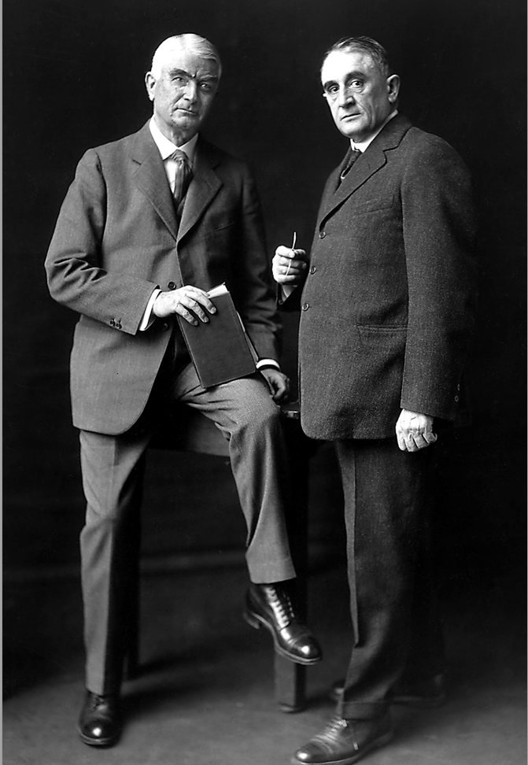
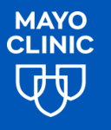
History & heritage Highlights

Slide 2
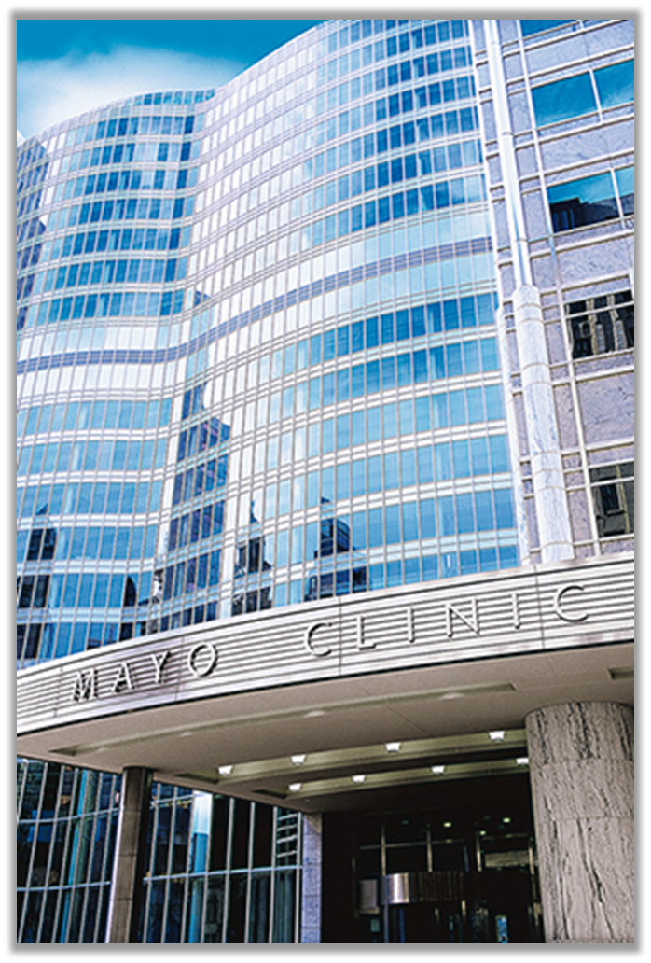
Mayo clinic is….
The first and largest integrated not-for-profit medical group practice in the world.
But how did Mayo Clinic begin?

Slide 3
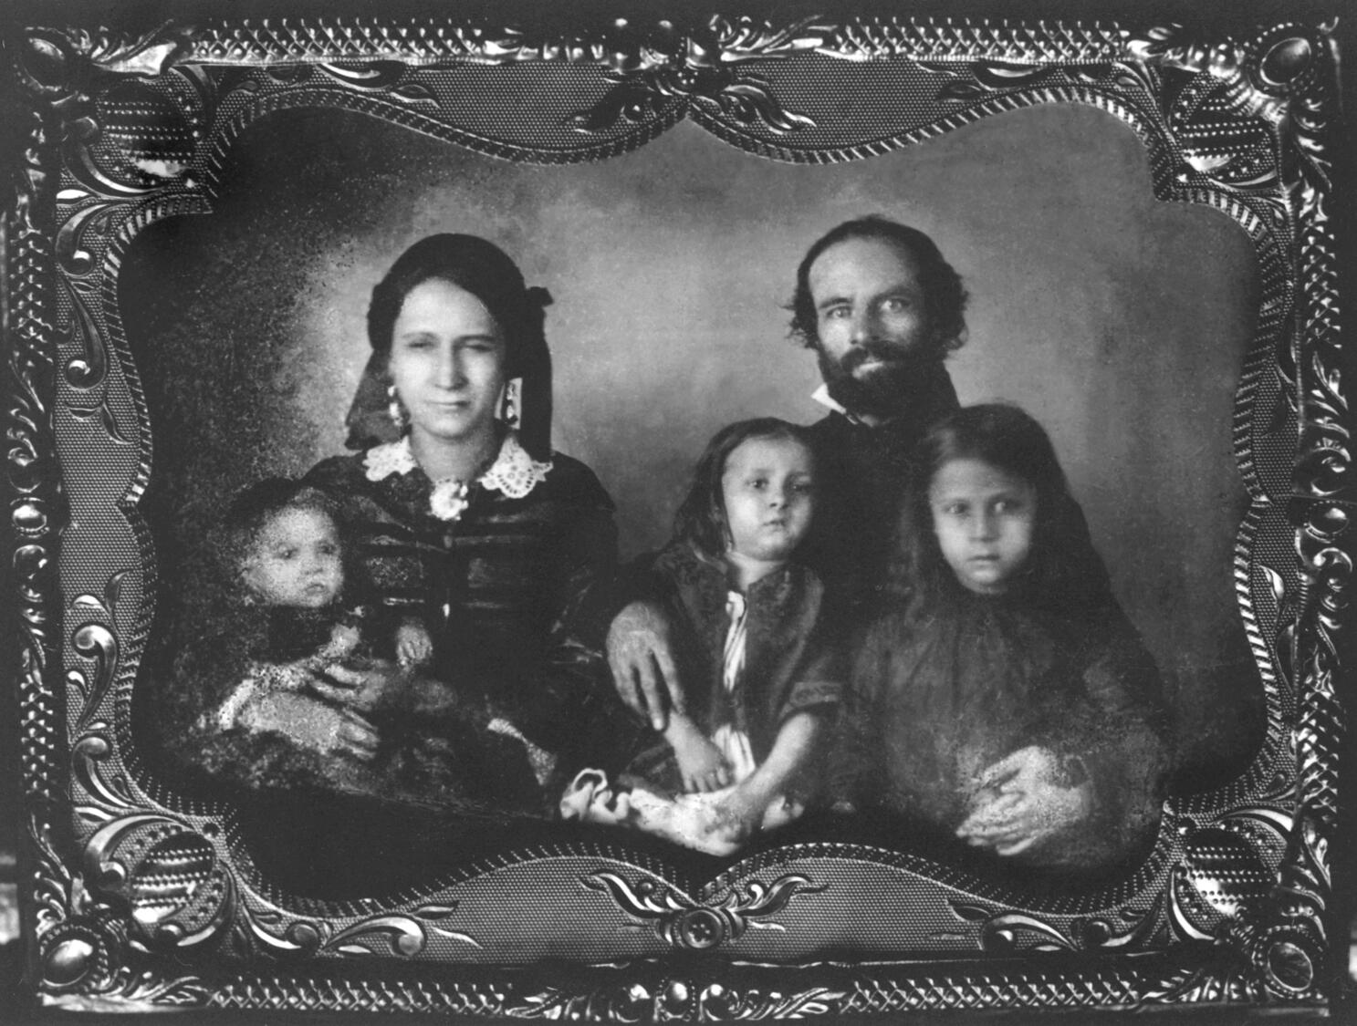
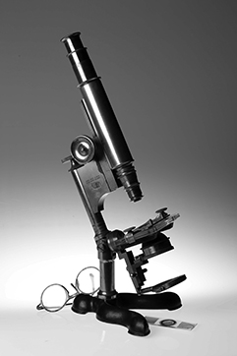
1864
Dr. William WorraLl mayo arrives in Rochester
Dr. W. W. Mayo came to Rochester with his young family in 1864, at the request of President Abraham Lincoln, to examine recruits for the Union Army.
As his medical practice grew, Dr. W. W. Mayo and his wife, Louise, mortgaged their home to purchase a microscope so he could provide optimal care to his patients.
Photo of Dr. W.W. Mayo (holding daughters Phoebe, age 5, and Gertrude, age 8) with wife Louise (holding Sarah, 10 months).
©2025 Mayo Foundation for Medical Education and Research | slide-3
Notes:
Daughter Sarah died at age (fill in). William James Mayo was born in 1861 and Charles Horace Mayo was born 1865.

Slide 4
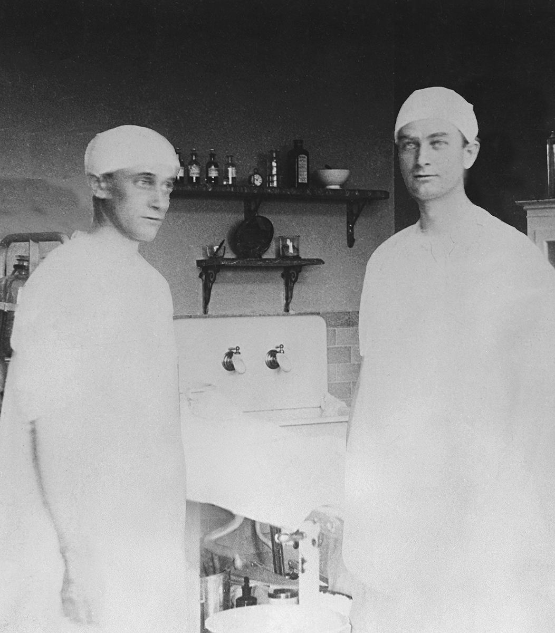
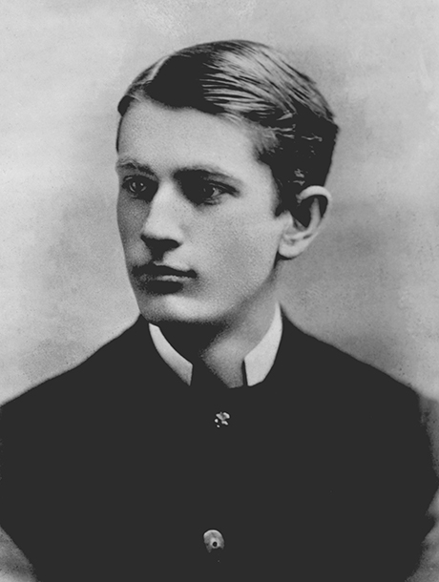
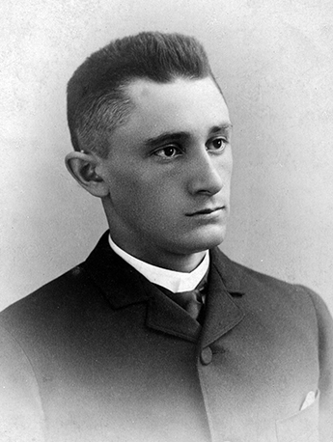
1883 & 1888
Dr. W. W. Mayo’s sons join him in practice after graduating from medical school
Dr. William J. Mayo
"Doctor Will"
Dr. Charles H. Mayo
"Doctor Charlie"
©2025 Mayo Foundation for Medical Education and Research | slide-4

Slide 5
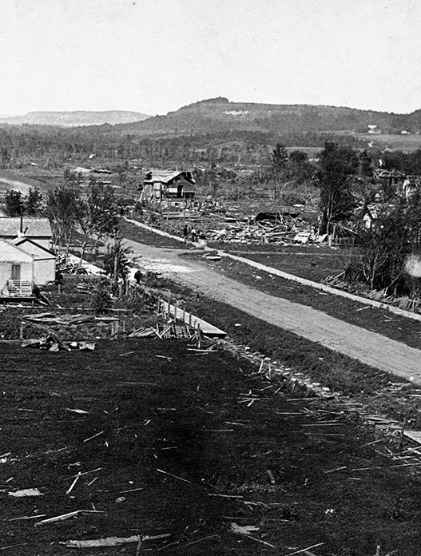
1883
After a tornado struck Rochester, Dr. W.W. Mayo called on the Sisters of St. Francis, a Catholic teaching order, to assist in providing medical care to the injured.
Watch the Heritage Film, “Born in a Storm” at history.mayoclinic.org to learn more.

Slide 6
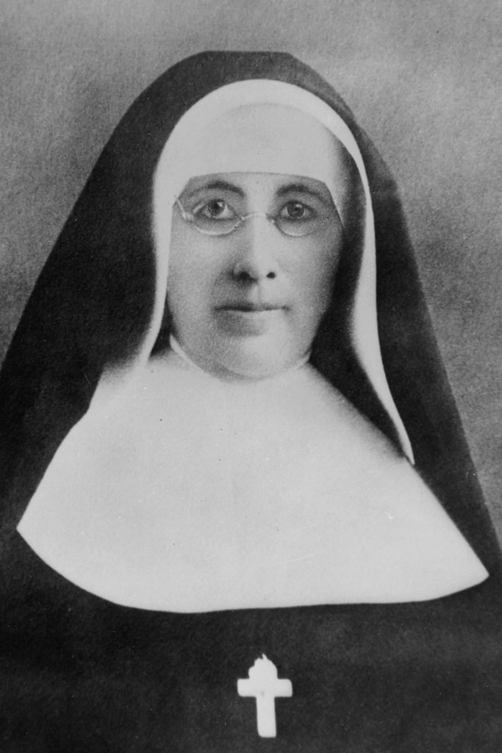
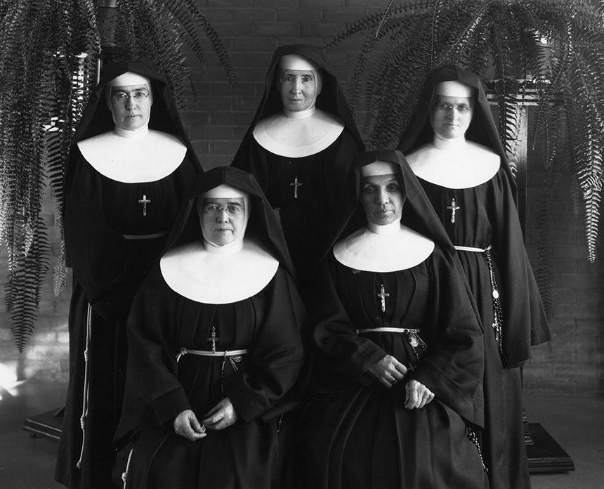
1883
Mother Alfred Moes has a vision
Mother Alfred Moes of the Sisters of Saint Francis offered to build and staff a hospital if
Dr. W. W. Mayo and his sons would provide the medical care. They agreed with a handshake.

Slide 7
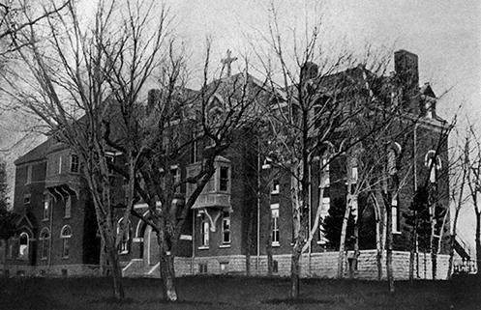
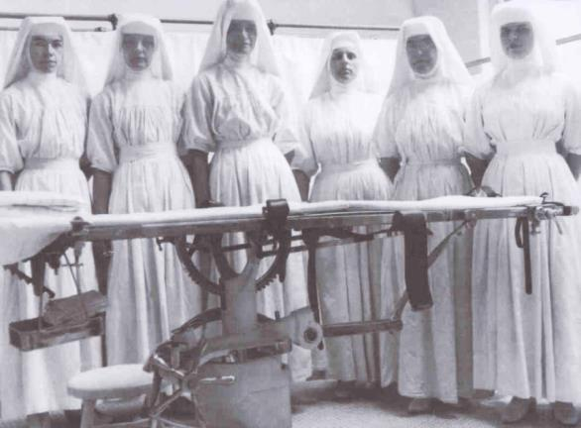
1889 saint Marys Hospital opens with
27 beds
Word spreads of the “hospital in the cornfield” and the skill of the Mayo brothers as surgeons.
  The Mayo brothers worked closely with the Franciscan Sisters, employing the latest antiseptic techniques in surgery. In 1906, to address the need for more nurses, the Saint Marys School of Nursing is established.

Slide 8
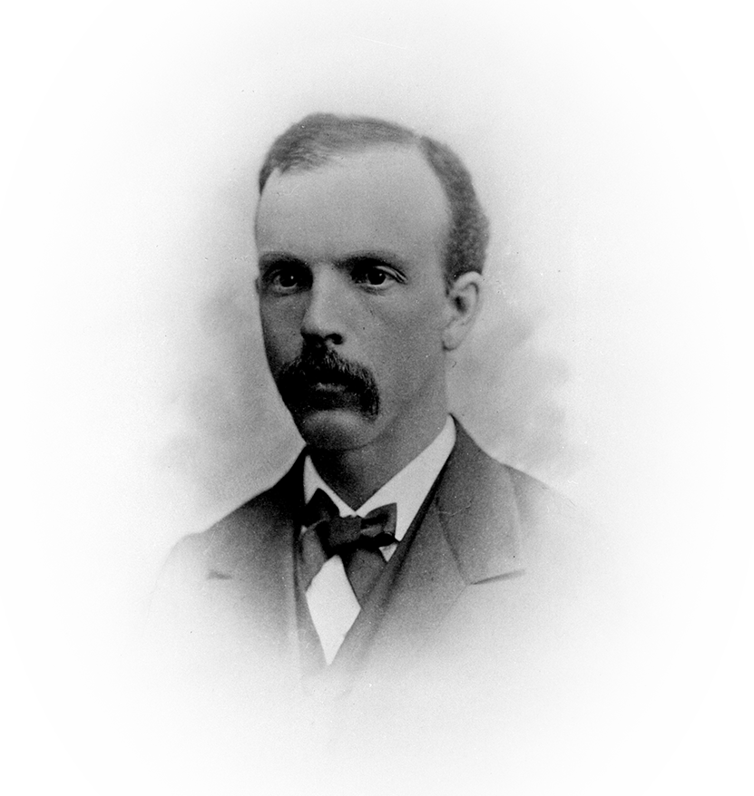
1892
Innovation and Teamwork
  Innovation was the standard of the Mayo practice from the beginning. As the demand for their services increased,
  Dr. Will and Dr. Charlie welcomed partners and associates whose skills complemented their own.
  In this way they established the model of teamwork that continues today.
The first partner, Augustus W. Stinchfield, M.D.,
is added to the Mayo family practice.

Slide 9
1905
Louis Wilson, M.D., is hired to develop laboratories
Dr. Wilson also developed a rapid way to diagnose surgical specimens, allowing Mayo surgeons to explore, diagnose and repair all in one operation.

Slide 10
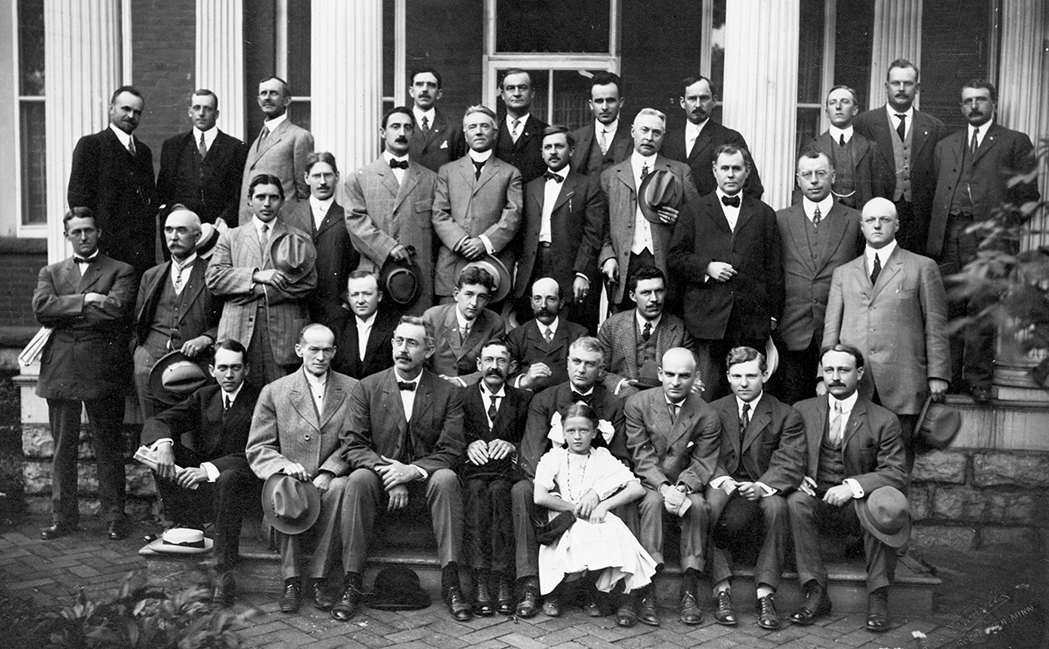
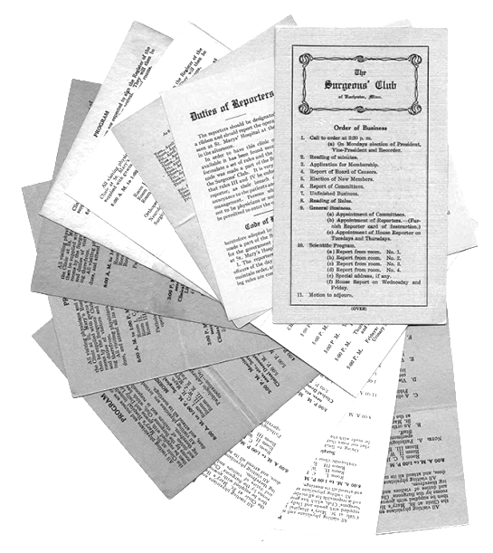
1906
EXCELLENCE
Visiting physicians organize the Surgeons Club, forerunner of
Mayo Clinic School
of Continuous Professional Development.

Slide 11
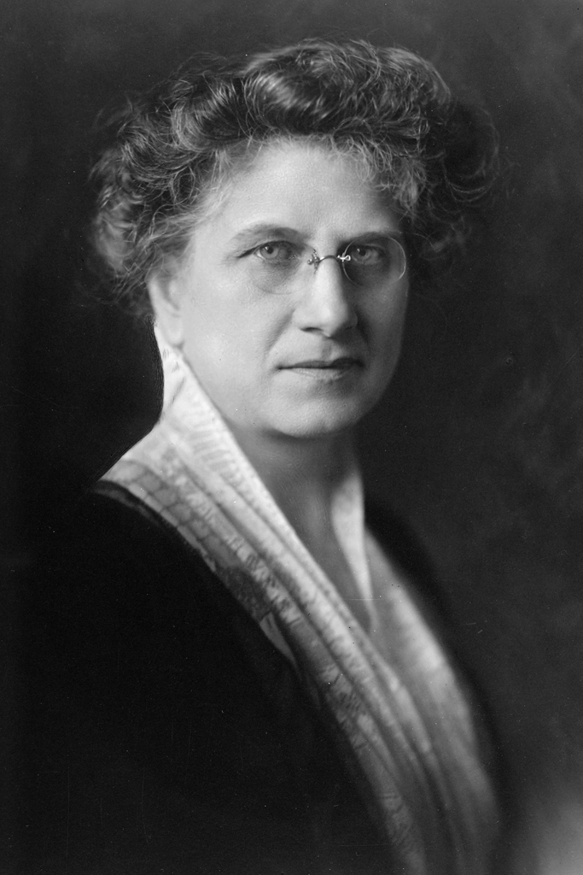
1907
Maud Mellish
Henry Plummer, M.D.
Hired to develop a library and perform editorial services for the staff.
Introduced the concept of integrated medical records for individual patients stored in a central place. The unified medical record is now the “gold standard” of documentation for patient care, research and education.
©2025 Mayo Foundation for Medical Education and Research | slide-11

Slide 12
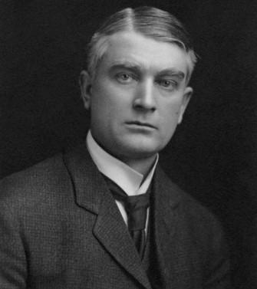
1910 teamwork
  “The best interest of the patient
  is the only interest to be considered,
  and in order that the sick may have
  the benefit of advancing knowledge,
  union of forces is necessary.”
  William J. Mayo, M.D., commencement address at Rush Medical College in Chicago
Notes:
His statement becomes the foundation of the primary value of Mayo Clinic –
the needs of the patient come first
and a classic declaration of Mayo Clinic’s commitment to teamwork.

Slide 13
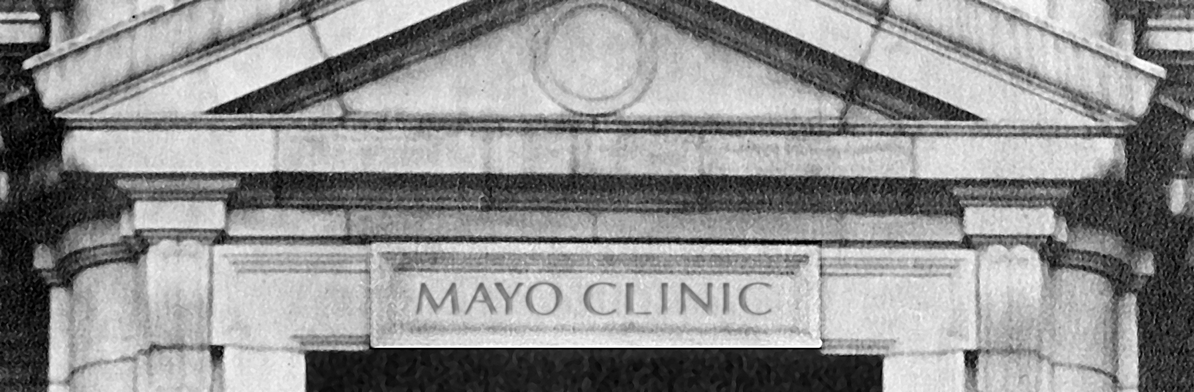
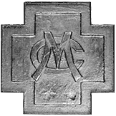
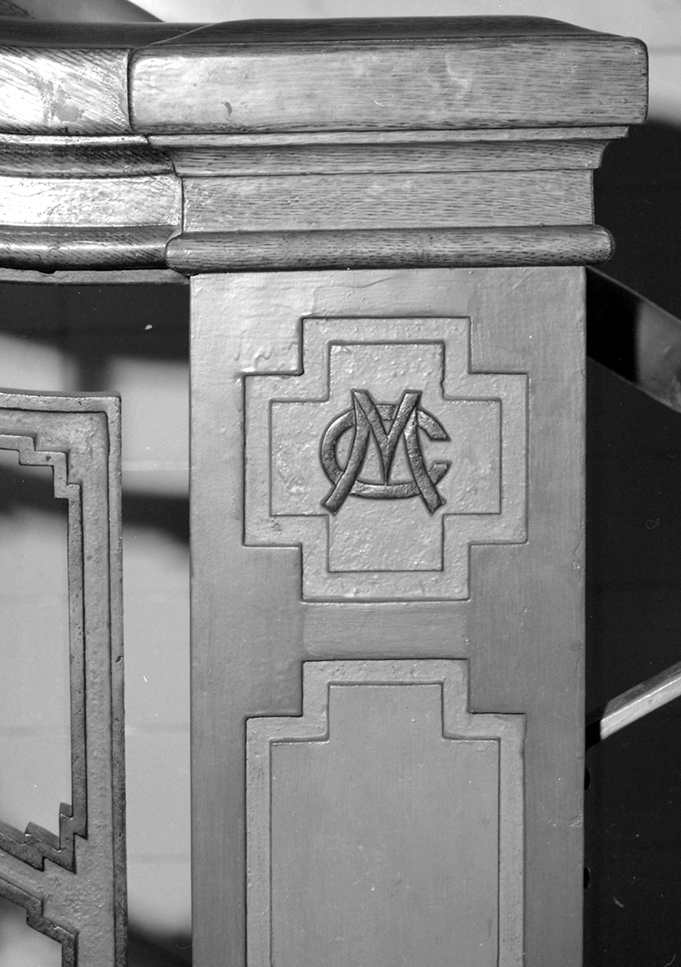
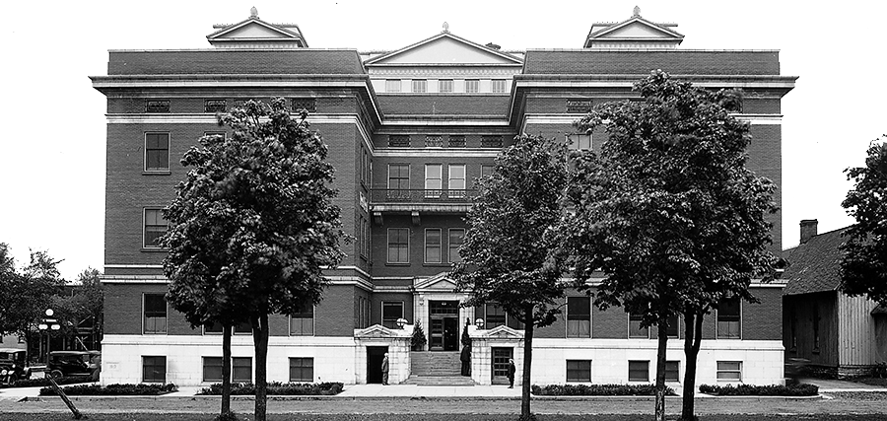
1914
Innovation
When the first building in the world designed for an integrated multispecialty group practice of medicine opened in 1914, the name “Mayo Clinic” was carved in stone above the front door.
Notes:
Although the Mayo doctors were initially viewed as unconventional for practicing medicine through this teamwork approach, the benefits of a private group practice were undeniable.

Slide 14
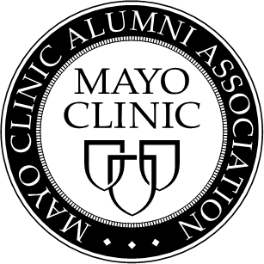
1915
Excellence
Doctors from all over the world came to observe and learn from Mayo physicians, leading to the organization of one of the first formal graduate training programs, now known as Mayo Clinic School of Graduate Medical Education.
1917
Physicians who trained at Mayo clinic established what now is known as the Mayo Clinic Alumni Association.

Slide 15
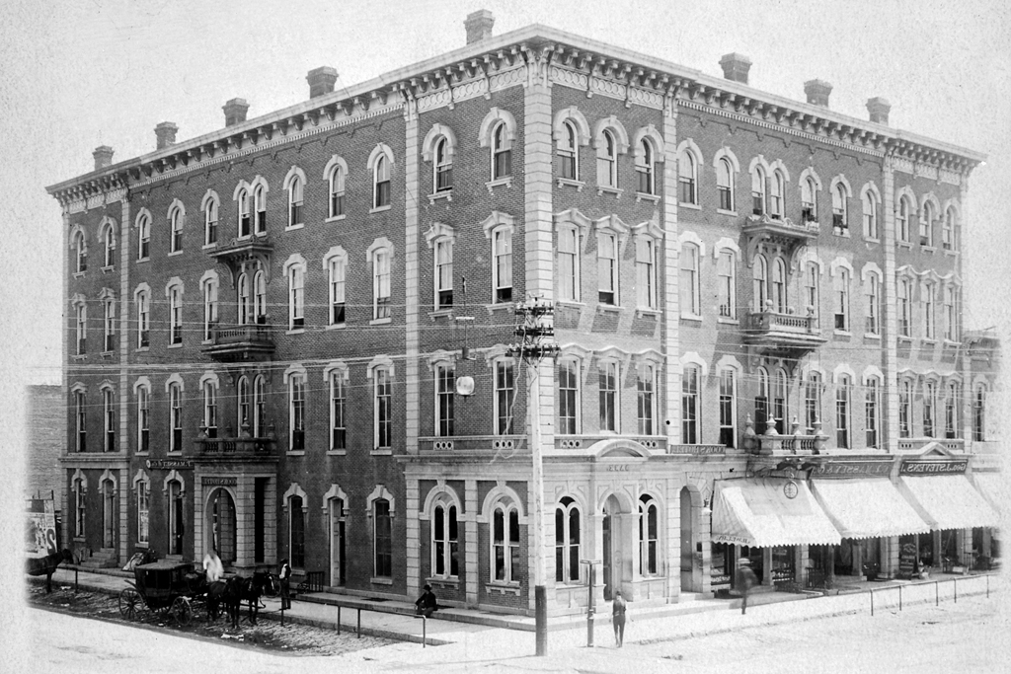
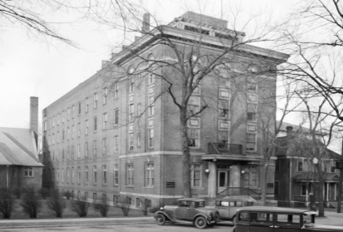
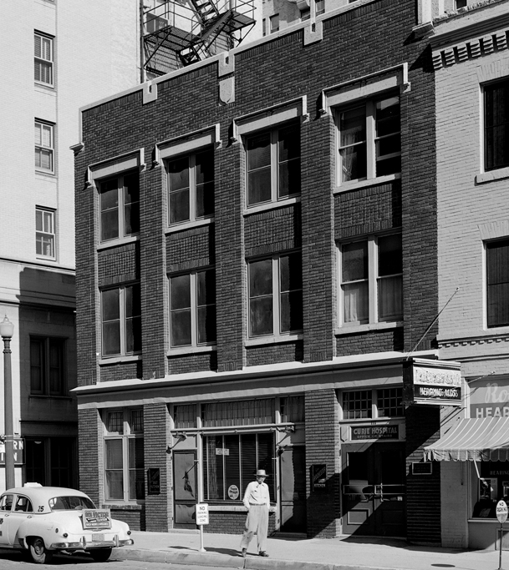
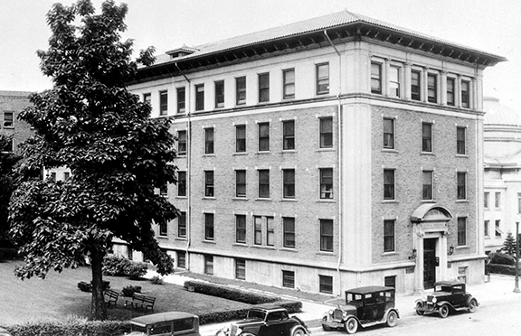
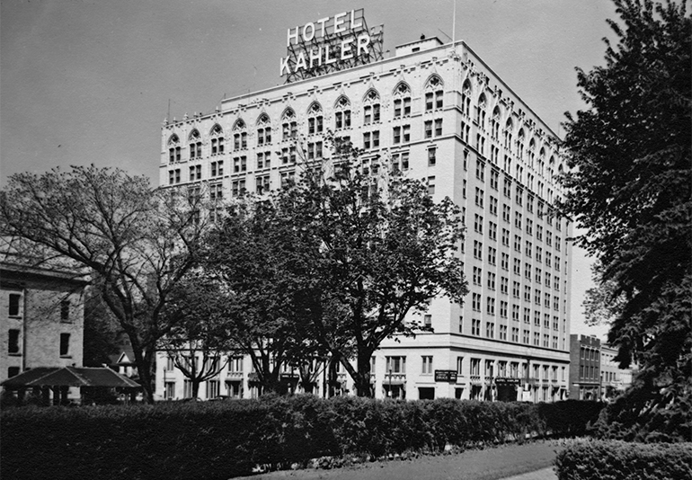
1915
Cook Hotel
Worrall Hospital
Saint Marys Hospital could not meet the rising demand from patients.
Rochester business leader John Kahler developed an innovative concept of hotel/hospitals in downtown Rochester, providing patients with increased access to medical care and places to recuperate from surgery.
Curie Hospital
Worrall Annex
Kahler Hotel & Hospital

Slide 16
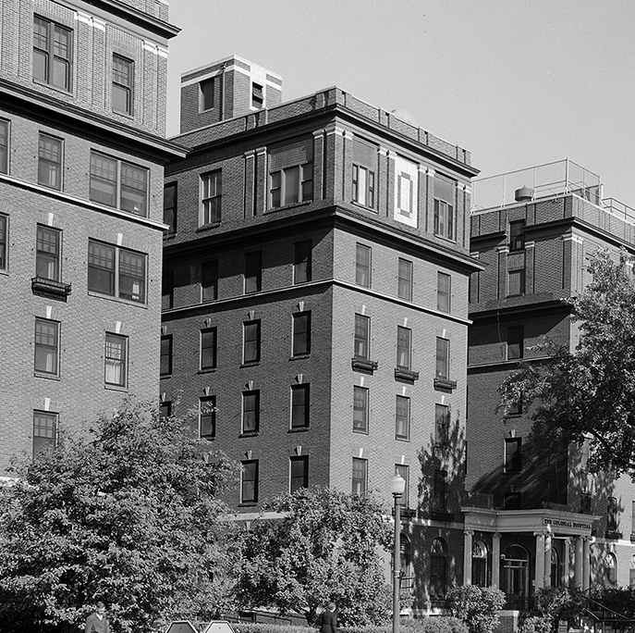
1919 healing
To address the shortage of nurses, Colonial Hospital Training School for Nurses was established in downtown Rochester.
In 1921 the name was changed to Kahler Hospital’s School of Nursing.

Slide 17
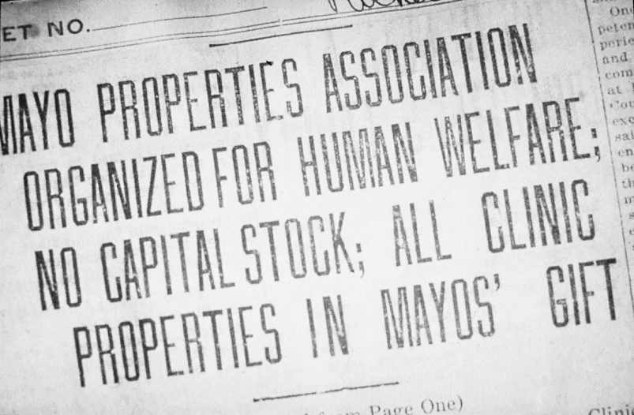
1919
Stewardship
To ensure the longevity of Mayo Clinic, the Mayo brothers and their wives signed a Deed of Gift, donating the assets of the private practice and the majority of their private savings to create a not-for-profit organization.
This gift, worth about $10 million at the time, was without precedent in medicine.

Slide 18
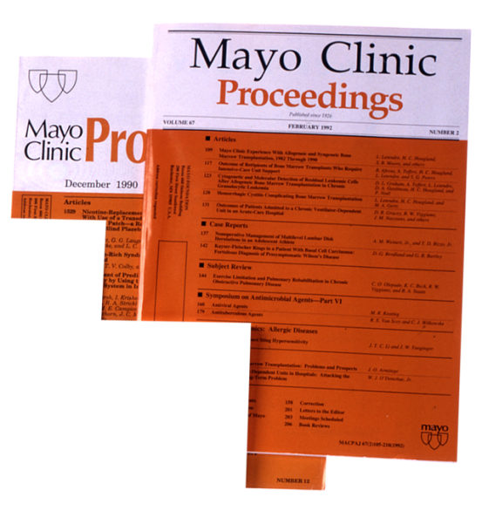
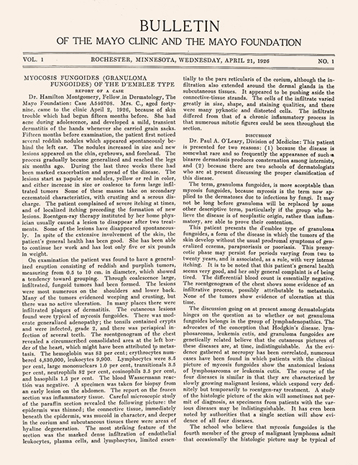
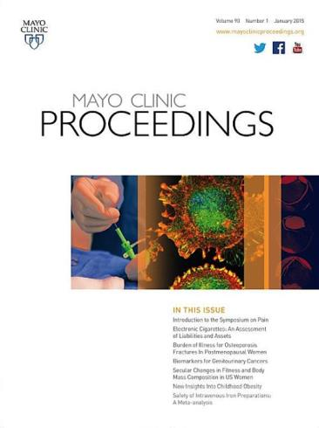
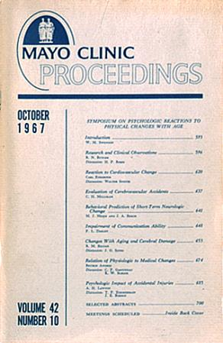
1926 integrity
The first issue of Mayo Clinic Proceedings, a summary of staff activities, is published. In 2021 there were more than 6 million downloads of its journal content.
Mayo Clinic logo1927

Slide 19
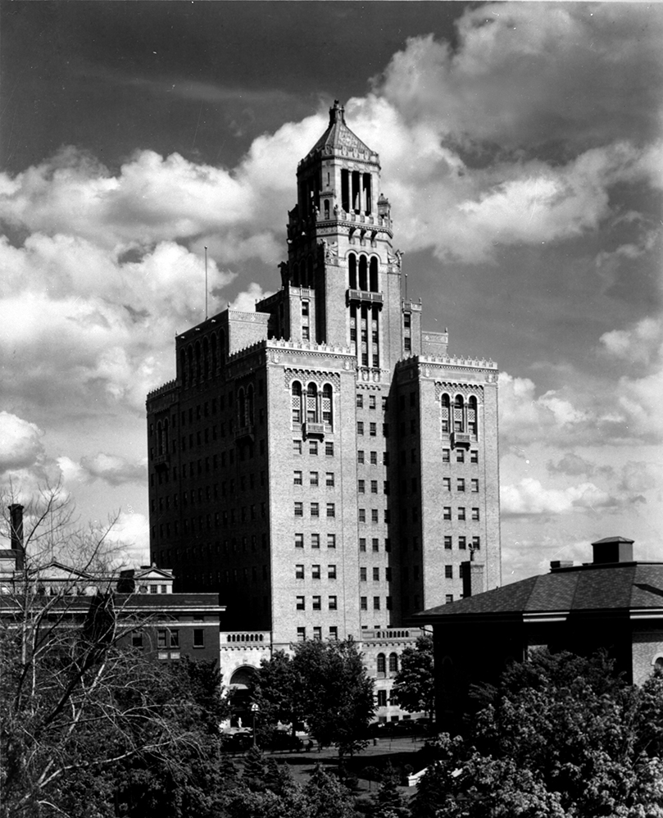
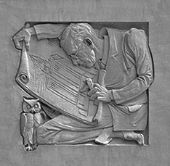
1928
The Plummer Building opened.
A triumph of engineering and aesthetics, it exemplifies the Mayo brothers’ ideal of serving humanity through medical science.

Slide 20
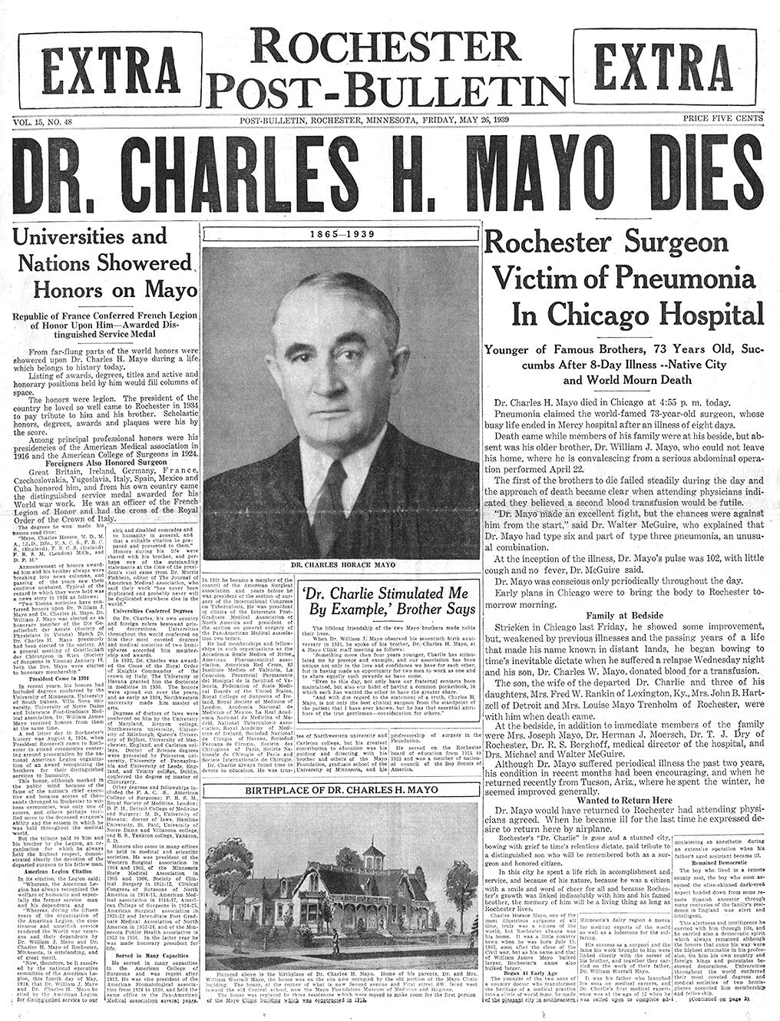
May 26,1939 respect
After an eight-day illness, Dr. Charlie passed away.
The nation and the world joined Rochester residents in mourning his death.

Slide 21
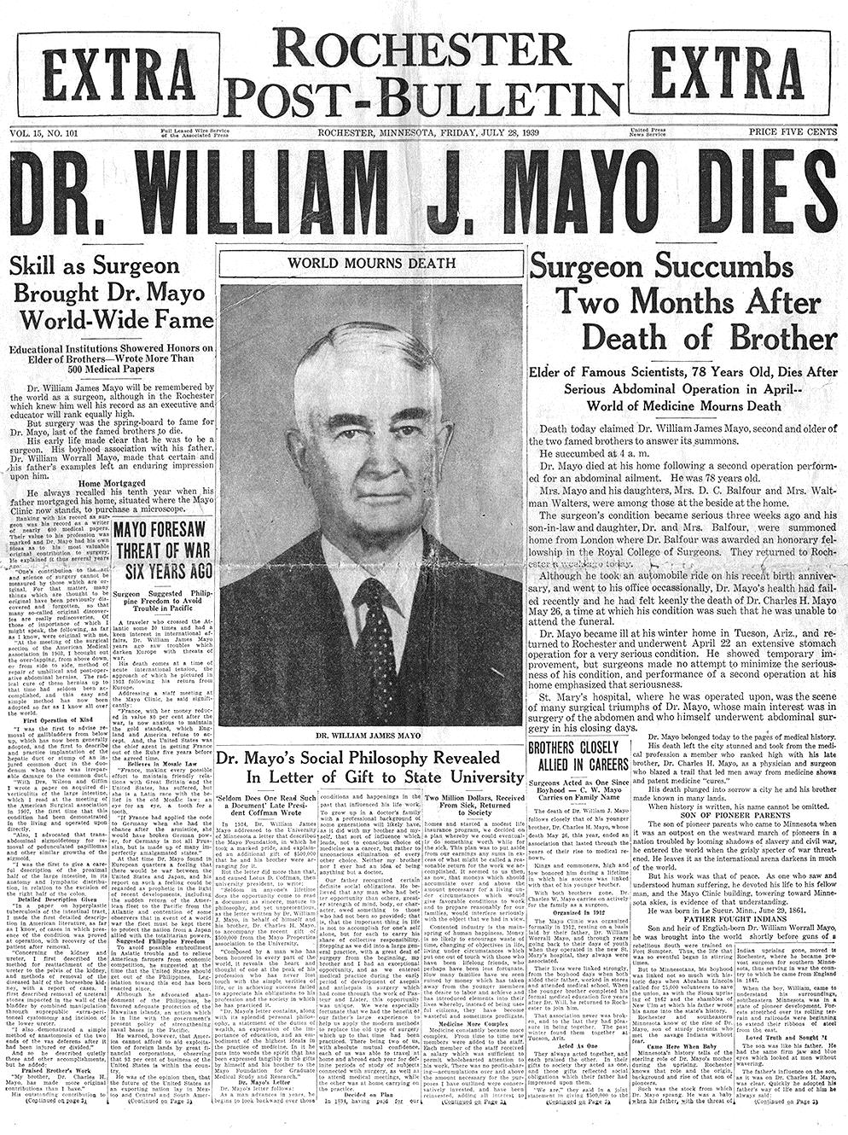
July 28, 1939
Integrity
Two months later, the world mourned once again when Dr. Will passed away in Rochester.
Many expected the demise of Mayo Clinic.
Through the wise planning of the Mayo brothers and hiring of capable colleagues to positions of leadership Mayo Clinic continued to thrive.

Slide 22
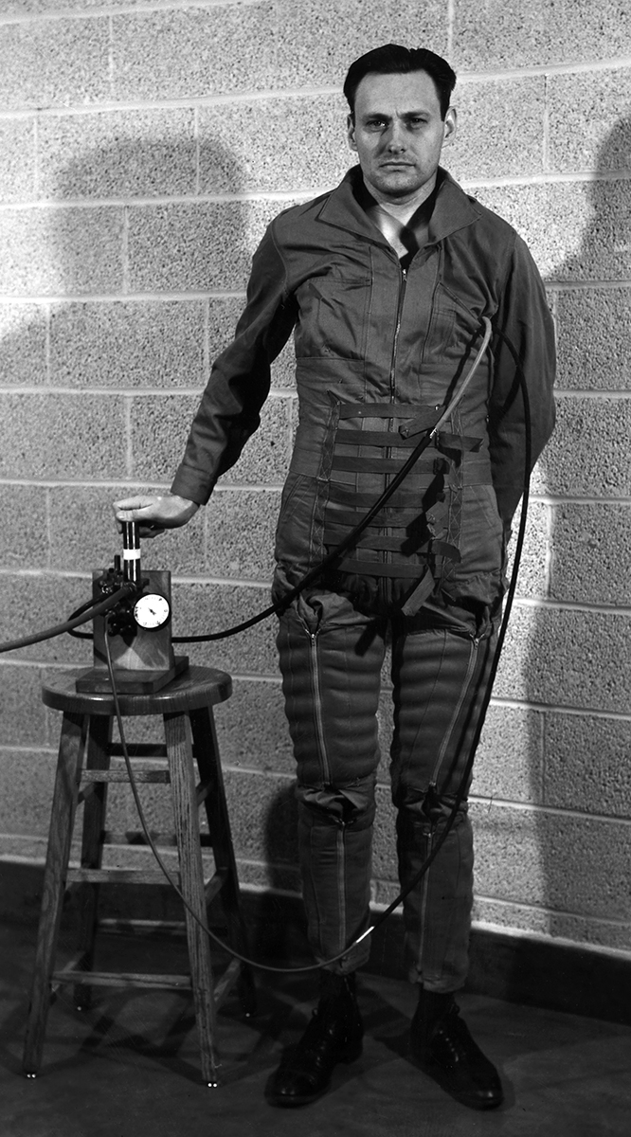
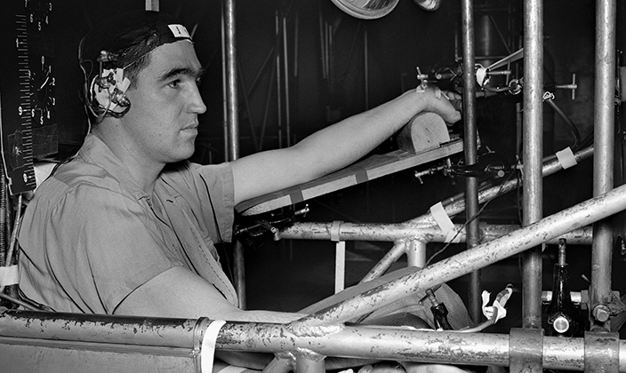
World War II innovation
Mayo’s Aero Medical Unit helped develop the oxygen mask and G-suit that gave American aviators an advantage in the air war in Europe and the Pacific.

Slide 23
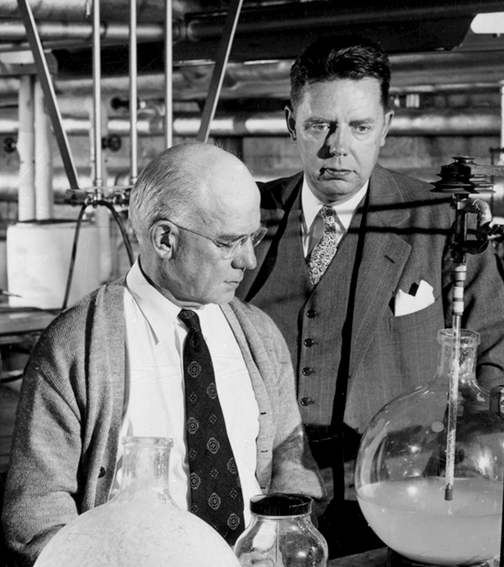
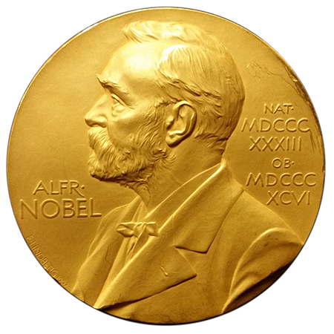
1950
Excellence
Mayo Clinic researchers Edward Kendall, Ph.D., (left) and Philip Hench, M.D.,(right), shared the Nobel Prize for discovery of cortisone.

Slide 24
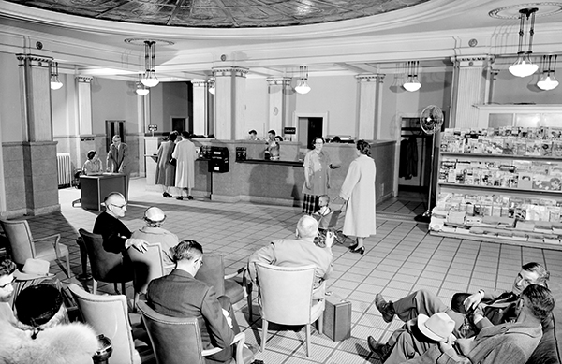
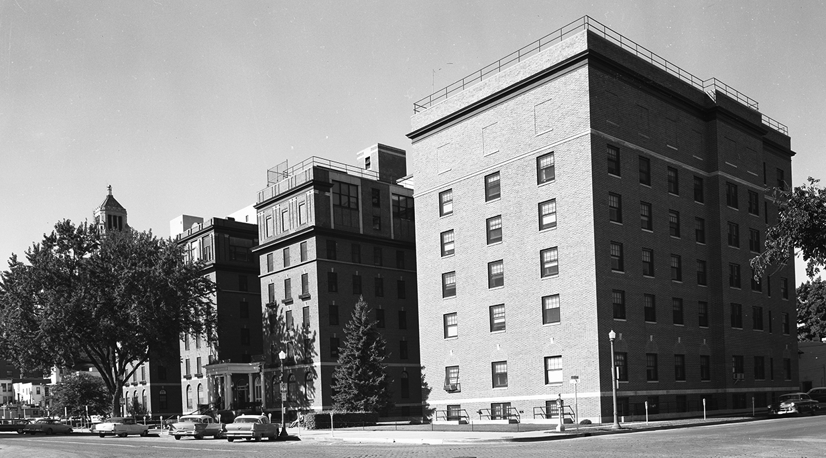
Early 1950s
Rochester Methodist Hospital formed in 1954.
Notes:
The Kahler Corporation moved away from managing hospitals.
Through the efforts of local business leaders, Mayo Clinic officials and the Methodist National Board of Hospitals and Homes, Rochester Methodist Hospital became a corporate reality in 1954.

Slide 25
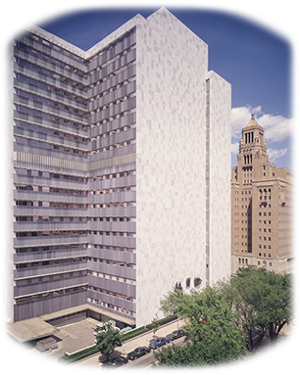
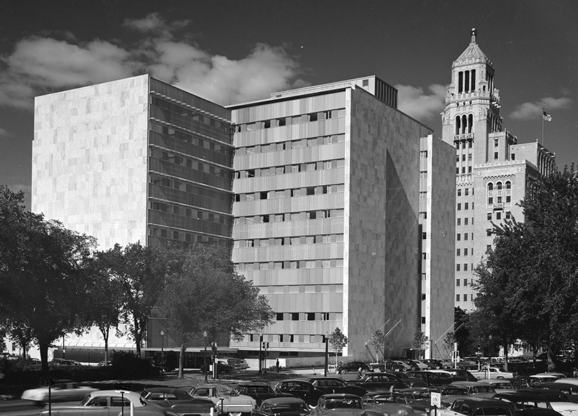
1955
Stewardship
Unprecedented growth prompted construction of the Mayo Building. The 10-story building was completed in 1955.
An eight-story addition is completed between 1966-1970.

Slide 26
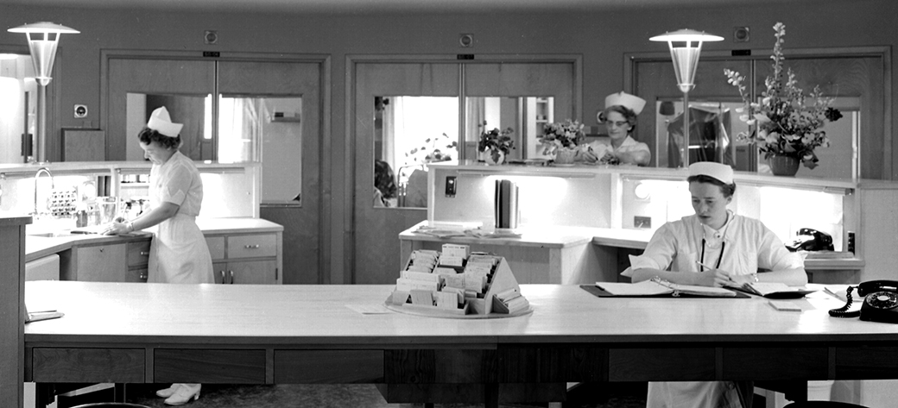
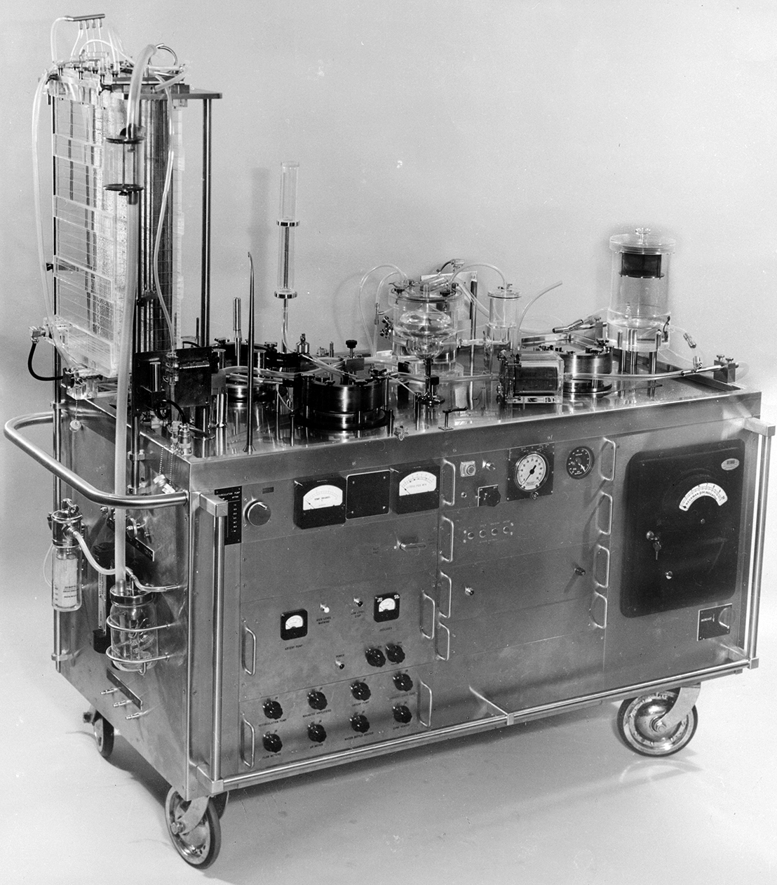
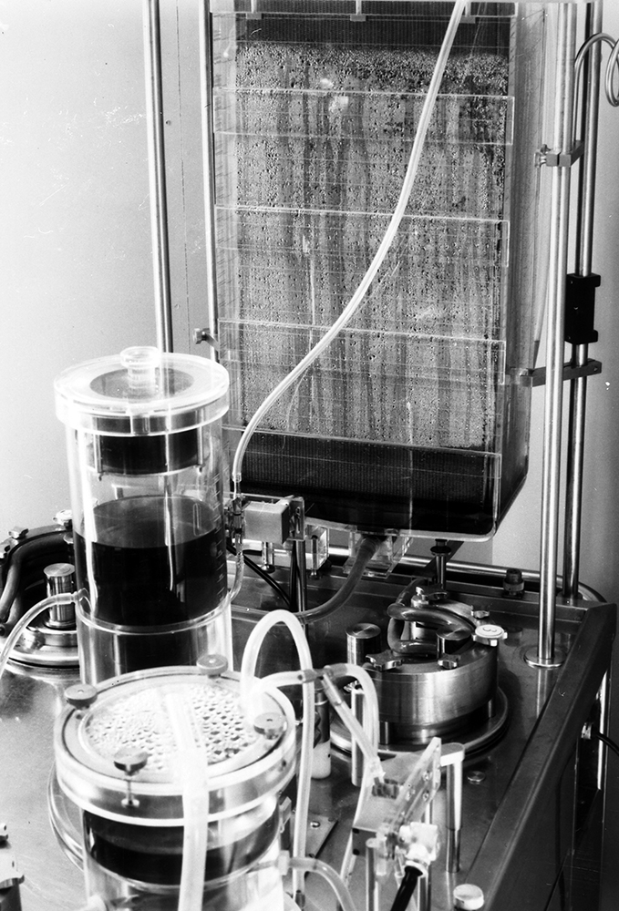
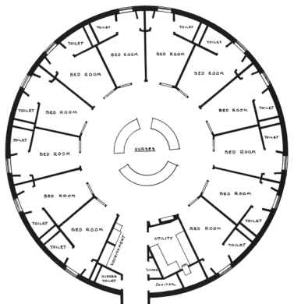
1955
HEALING
Mayo Clinic helped revolutionize
open-heart surgery with the Mayo-Gibbon Heart-Lung Bypass Machine.
One of the first intensive care units opens with an innovative radial design.

Slide 27

1958
Innovation
Mayo Clinic received its first
grant from the National Institutes
of Health (NIH).
Today, Mayo Clinic is one of the leading recipients of NIH funding, which confirms the high quality
of Mayo’s research initiatives.
©2025 Mayo Foundation for Medical Education and Research | slide-27
Image copyright EyeEm

Slide 28

1964 Centennial Year stewardship
The U.S. Postal Service issued a commemorative stamp in honor of the Mayo brothers.
The centennial seal was the first depiction of practice (patient care), education and research, which were visually represented in the 1970s as the three-shield logo of Mayo Clinic.

Slide 29


1966
The new Rochester Methodist Hospital building is dedicated

Slide 30


1969 healing
Mayo Clinic surgeon Mark Coventry, M.D., implants the first FDA-approved artificial hip joint.

Slide 31



1972
Mayo Medical School opens with Raymond D. Pruitt, M.D. as founding dean.
The school across all campuses is now known as Mayo Clinic Alix School of Medicine.

Slide 32


1973
Innovation
Mayo Clinic introduces the CT scanner to North America, transforming the field of medical imaging.

Slide 33




1973
Training programs for allied health professionals are aligned in what today is known as Mayo Clinic School of Health Sciences

Slide 34


1984 teamwork
Mayo One Ambulance, now Mayo Clinic Ambulance Service, begins service

Slide 35


1986
Mayo Clinic, Saint Marys Hospital, and Rochester Methodist Hospital integrate into a single organization, a “trusteeship for health.”

Slide 36



1986 Mayo Clinic expands to Jacksonville, Florida
Mayo Clinic logo – 1986

Slide 37


1986 Mayo Clinic expands to Jacksonville, Florida
1987 Mayo Clinic expands to Scottsdale, Arizona

Slide 38





1989
Mayo Graduate School established. It is now known as Mayo Clinic Graduate School of Biomedical Sciences.
Photos from 1989 MGS brochure.

Slide 39

1992
Mayo Clinic Health System established,
providing high-quality
care in local communities
with access to Mayo Clinic for specialty care.
Mayo Clinic Health System 2023

Slide 40

1998
Mayo Clinic Hospital opens in Phoenix, Arizona

Slide 41


2001
Following the 9/11 terrorist attacks,
Mayo Clinic developed a rapid test
to diagnose anthrax poisoning
Mayo Clinic logo – 2001

Slide 42

2008
Mayo Clinic opened a new 214-bed hospital in Jacksonville, Florida

Slide 43


2011
The Mayo Clinic Care Network forms to extend Mayo’s expertise and resources to health care organizations around the world

Slide 44





2013-2014
Mayo Clinic commemorated its sesquicentennial honoring 150 years of the Mayo medical practice, serving humanity with hope and healing.
Mayo Clinic logo – 2011

Slide 45

For more information about Mayo Clinic history and heritage
Films & Books
Timelines
Contributions to Medicine
Quotations
Tours & Events
History.mayoclinic.org
©2023 Mayo Foundation for Medical Education and Research

